Slide 1
RSP Retrieval Examples
Brian Cairns, Jacek Chowdhary

Slide 2
Agenda
Instrument Performance
Aerosols
  Over Ocean
  Over Land
Clouds
  Water Clouds
    Aerosols Over Clouds
  Ice Clouds
Summary

Slide 3
Instrument Performance

Slide 4
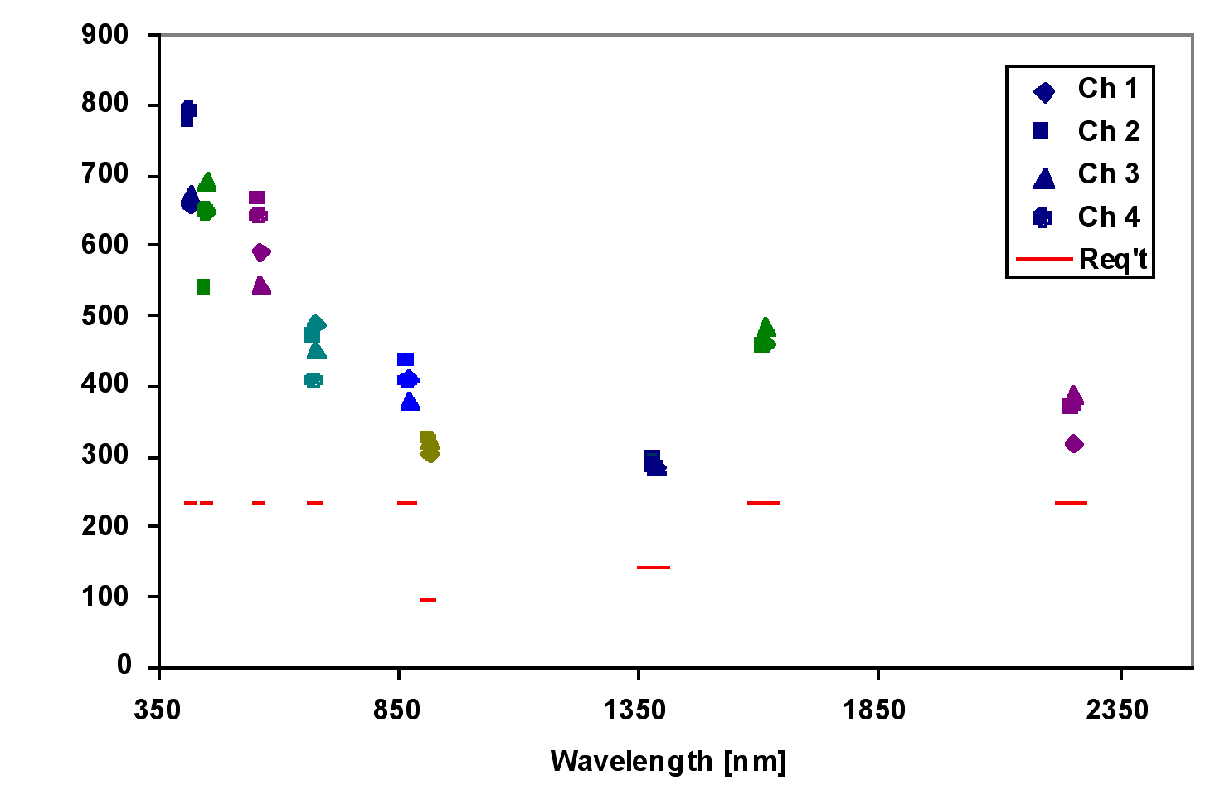
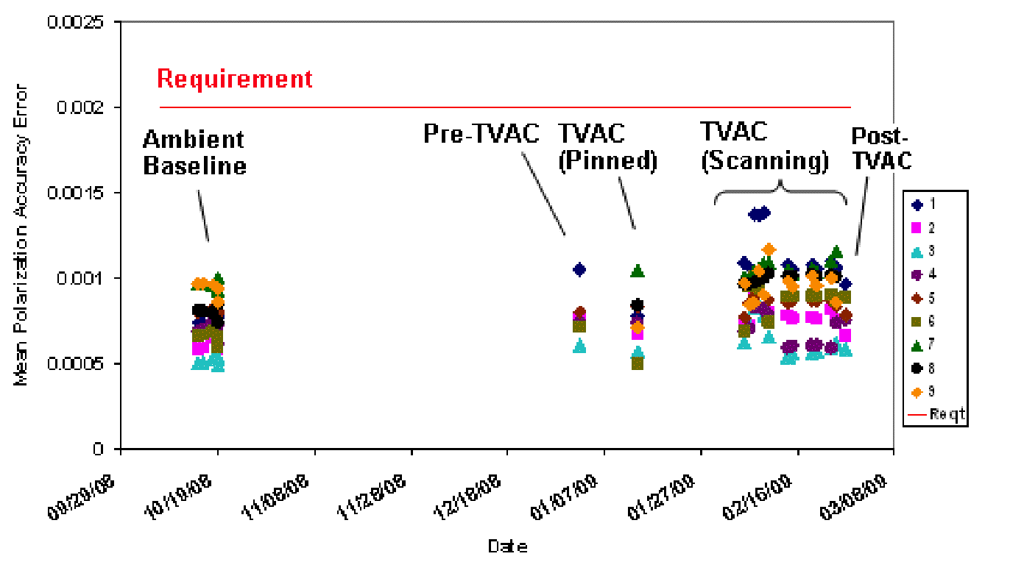
Instrument Performance
APS demonstrated extremely good performance throughout testing
Test summary
  The APS was tested extensively at Raytheon and the baseline performance continued to be tracked at Orbital. The APS had small polarimetric uncertainty (polarization accuracy) and very high SNR.
    Figure on left below is predicted SNR per view over dark ocean with global mean optical depth. Figure on right is mean accuracy over range of polarization inputs.

Slide 5
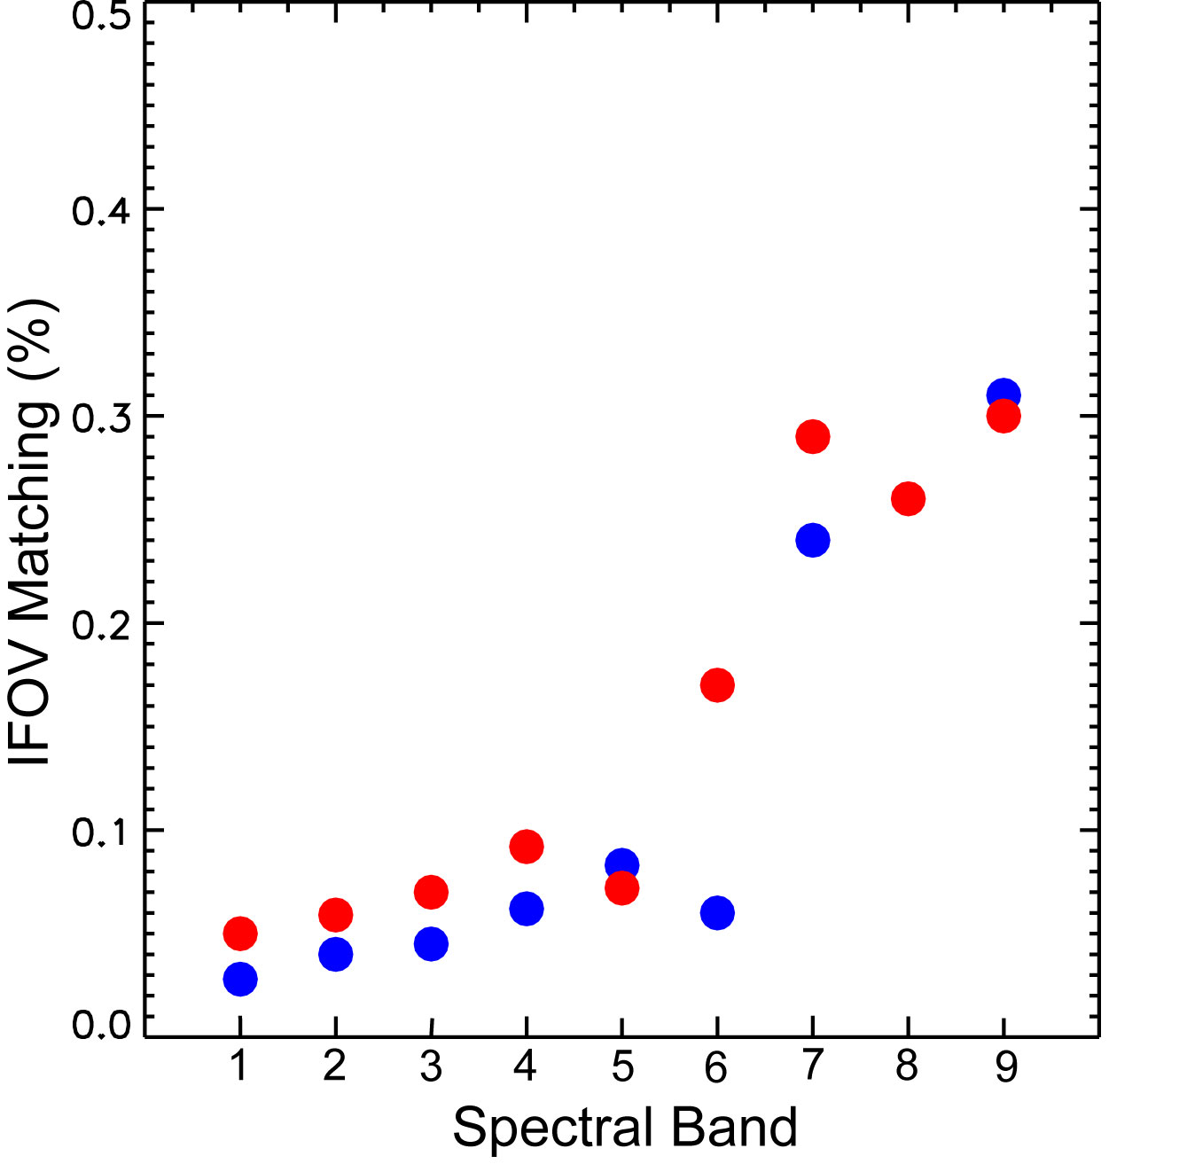
Instrument Performance
APS demonstrated extremely good performance throughout testing
Maximum polarization error caused by sub-pixel heterogeneity for an instrument such as APS or RSP can be shown, using a Cauchy-Schwartz inequality to be less than 0.5*IFOV_Matching*σ_{I}/I.
Tested for effects of sub-pixel (and polarization) heterogeneity
Data consists of:
  0.7 mrad collimator beam
  Collimator azimuth/elevation stage stepped through 15x15 grid in ~0.1 IFOV steps
For a black and white checkerboard pattern with 50% coverage σ_{I}/I takes on its maximum values of 1.
So IFOV_Matching < 0.5% guarantees polarization errors for 100% intensity modulation within the IFOV of <0.25%
Requirement

Slide 6
Aerosols

Slide 7
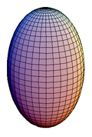
Aerosols
Over ocean
Non-spherical aerosol shapes
0.3
Dubovik et al. (JGR, 2006)
Feldspar
†
spherical
Aerosol property
Property range
0.2
equi-probable
major
real refractive index m:
1.33 ≤ m ≤ 1.60
Probability
minor
imaginary refractive index k:
0.0005 ≤ k ≤ 0.5
0.1
aspect ratio ε’:
1.0 ≤ ε’ ≤ 3.0
major
size parameter x:
0.012 ≤ x ≤ 625
aspect ratio ε’ ≡
0.0
2.0
3.0
minor
†
1.0
Pre-computed kernel lookup tables
Aspect ratio ε’
100
40
r_{e} = 2.0 μm
v_{e} = 1.0
m = 1.50
20
very little variation
10
Scattering function
0
spherical
Degree linear polarization
1
equi-probable
-20
λ = 2250 nm
λ = 2250 nm
0.1
180
-40
0
60
120
0
60
120
180
Scattering angle
Scattering angle
Notes:
Top: left graph shows that the shape of a spheroid can be defined by a single number, i.e. the aspect ratio. Top table shows range of aerosol properties for Dubovik’s spheroids. Top right graph shows various distributions of aspect ratio considered for this work.
Bottom left graph shows variation in scattering function with shape distribution (red, blue and black curves are for Feldspar-shape, spherical shape, and equi-probable aspect ratio). Bottom right graph shows corresponding variation in degree of linear polarization (DoLP). Note that DoLP varies very little in backscattering direction for red and grey aspect ratio distributions shown in right upper graph.

Slide 8
Aerosols
Over ocean
CLAMS field experiment
Remer et al. (JAS, 2005), Table 2
†
σ
†
λ = 1.64 μm
MODIS aerosols
r_{g}
r_{e}
v_{e}
m:
λ ≤ 1.24 μm
λ = 2.14 μm
wet sea salt (S1)
0.40
0.60
0.98
0.43
1.45−0.0035i
1.43−0.0035i
1.43−0.0035i
wet sea salt (S2)
0.60
0.60
1.48
0.43
1.45−0.0035i
1.43−0.0035i
1.43−0.0035i
wet sea salt (S3)
0.80
0.60
1.98
0.43
1.45−0.0035i
1.43−0.0035i
1.43−0.0035i
water soluble
0.06
0.60
0.15
0.43
1.45−0.0035i
1.43−0.0100i
1.40−0.0050i
†
in μm
July 17, 2001
Chesapeake Bay
no ocean body
Altitude:
3.6 km
Sun angle:
~22°
Azimuth angle:
179°
sun glint
Total reflectance
sun glint
S1 + F1
Polarized reflectance
S2 + F1
λ = 550 nm
S3 + F1
λ = 865 nm
λ = 1590 nm
λ = 2250 nm
view angle
view angle
Notes:
The top Table shows various MODIS aerosol candidate models.
In the bottom graphs, MODIS fine and salt aerosol candidate models are used to fit RSP reflectance. The left panel shows that multiple salt models lead to a good fit for the total reflectance (overlapping curves are shown as to parti-colored curves). The right panel shows that none of these salt models reproduces the corresponding polarized reflectance. The multiple models only overlap at 550 nm which is why there is the one parti-colored line.

Slide 9
Aerosols
Over ocean
CLAMS field experiment
Chowdhary et al. (JAS, 2002), AGU 2007
†
λ ≤ .865 μm
RSP aerosols
shape
r_{e}
v_{e}
m:
λ = 1.59 μm
λ = 2.25 μm
†
salt-like coarse (C1)
spheroids
†
2.0
0.5
1.43−0.0005i
1.41−0.0005i
1.39−0.0005i
salt-like coarse (C2)
spheroids
3.0
0.5
1.47−0.0005i
1.43−0.0005i
1.41−0.0005i
salt-like coarse (C3)
spheroids
4.0
0.5
1.49−0.0005i
1.43−0.0005i
1.41−0.0005i
fine mode
spherical
0.15
0.2
≥1.42−0.01i
1.41−0.01i
1.40−0.01i
†
†
in μm
†
equi-probable aspect ratio distribution
July 17, 2001
Chesapeake Bay
no ocean body
Altitude:
3.6 km
Sun angle:
~22°
Azimuth angle:
179°
sun glint
Total reflectance
sun glint
C1 + F
Polarized reflectance
C2 + F
λ = 550 nm
C3 + F
λ = 865 nm
λ = 1590 nm
λ = 2250 nm
view angle
view angle
Notes:
Top: Table shows RSP retrieved sulfate-like fine mode aerosol and various non-spherical salt-like coarse mode aerosols.
Bottom: left and right graphs show that RSP aerosol retrievals fit both RSP total and polarized reflectance, respectively. Because of the noise in polarized reflectance at 2250 nm, the uncertainty in salt aerosol mode is large.

Slide 10
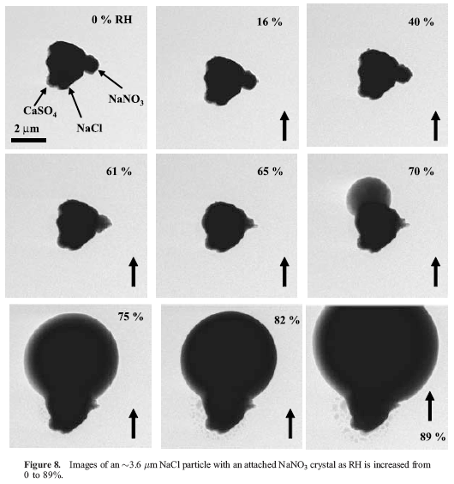
Aerosols
Over ocean
CLAMS field experiment
Chowdhary et al. (JAS, 2002), AGU 2007
†
v_{e}
m(λ ≈ 2.2 μm)
Coarse mode
r_{e}
shape
m(λ ≈ 1.6 μm)
RSP aerosols
3.0 ± 1.0
0.5
spheroids
1.42(±.01) –.0005i
1.40(±.02) –.0005i
MODIS aerosols
1.5 ± 0.5
.0.4
spherical
1.43 –.0035i
1.43 –.0035i
†
in μm
Individual natural particles from marine air masses
1000
λ = 0.865 μm
+
AERONET:
+
+
+
+
MODIS aerosols:
+
Salt S3
+
Salt S2
100
Salt S1
Scattering function
+
+
+
RSP aerosols:
+
r_{e} = 4.0 μm
+
r_{e} = 3.5 μm
+
r_{e} = 3.0 μm
10
+
0
5
10
15
r_{e} = 2.5 μm
r_{e} = 2.0 μm
Scattering angle
Wise et al. (JGR, 2007)
Notes:
Top: Table shows large possible size variation in MODIS and RSP coarse mode aerosols, but similarities in (salt-like) refractive indices
Bottom: left graph compares diffraction peaks of RSP and MODIS coarse mode aerosols with measurements by AERONET. Note that MODIS coarse mode aerosols cannot reproduce AERONET diffraction peak, whereas RSP coarse mode aerosol can. The right graph shows growth with RH of salt particle into a mix of spherical (soluble part) and non-spherical (non-soluble part) particle shape, which may be the coarse mode aerosol observed by RSP

Slide 11
Aerosols
Over ocean
CLAMS field experiment
Chowdhary et al. (JAS, 2002), AGU 2007
†
τ(λ ≈ 2.2 μm)
Coarse mode
r_{e}
τ(λ ≈ 1.6 μm)
RSP aerosols
2.0(C1) 3.0(C2) 4.0(C3)
.016(C1) .013(C2) .011(C3)
.015(C1) .013(C2) .011(C3)
MODIS aerosols
1.0(S1) 1.5(S2) 2.0(S3)
.012(S1) .009(S2) .006(S3)
.009(S1) .007(S2) .006(S3)
†
in μm
100.0
100.0
RSP aerosols
λ = 2.25 μm
MODIS aerosols
10.0
RSP aerosols:
10.0
r_{e} = 2.0 μm
scattering function
r_{e} = 3.0 μm
scattering function
r_{e} = 4.0 μm
1.0
(C1)
1.0
(S3)
MODIS aerosols:
r_{e} = 1.0 μm
r_{e} = 1.5 μm
r_{e} = 2.0 μm
0.1
0.1
0
50
100
150
0
50
100
150
scattering angle
scattering angle
Notes:
Top: Table shows that the coarse mode RSP (non-spherical) aerosol leads to AOD that are much larger than AOD retrieved with MODIS (spherical) aerosol.
Bottom: left graph shows scattering functions for RSP coarse mode aerosols. Right graph shows scattering functions for MODIS coarse mode aerosols. Note first that backscattering by RSP aerosols is substantially smaller than backscattering by MODIS aerosols. This explains difference in aerosol optical depth retrieved from RSP and MODIS aerosols in top Table. Secondly, diffraction peak for RSP aerosols is again much larger than diffraction peak for MODIS aerosols. IMPORTANT: these diffraction peaks are for 2250 nm, whereas the ones in the previous slide are for 865 nm.

Slide 12
Aerosols
Over ocean
Ocean model
bulk ocean
suspended matter
F_{blk} =
b_{w} F_{w} + b_{p} F_{p}
b_{w} + b_{p}
RT
remote sensing
F_{p} = F (shape, n, m)
R _{ocean} (view, λ, Chl)
ω_{blk} =
b_{w} + b_{p}
Variables provided by user
b_{w} + b_{p} + a_{tot}
Assume Rayleigh-Gans P
Chowdhary et al. (AO, 2006; RSE 2011)
10⁻¹
Total
Polarized
z
0°
φ
0°
φ
no fluorescence
θ
300°
120°
300°
120°
10⁻²
y
RT results (D-P)
μ =
irradiance ratio
φ
240°
120°
240°
120°
10⁻³
x
180°
180°
(reflectance x2)
(reflectance x4)
10⁻⁴
0.0 0.2 0.5 0.8 1.0 1.15 1.2 1.25 1.3 1.35 1.4 1.45 >
400
500
600
700
wavelength nm)
water-leaving radiance
Notes:
Top: Flow of RT computations. Quantities in blue are provided by user (e.g. from in situ data or from bio-optical model for given [Chl] and wavelength), whereas those in red are derived from Rayleigh-Gans -like underwater light polarization.
Bottom: left graph shows ocean color comparison between bio-optical prediction and RT results. Right graphs show examples of water-leaving total and polarized radiance as a function azimuth angle and of cos(view angle) for given sun angle

Slide 13
Aerosols
Over ocean
CLAMS field experiment
Chowdhary et al. (JAS, 2002), AGU 2007
†
†
τ(0.55 μm)
†
Fine mode
r_{e}
v_{e}
z_{bot}
z_{top}
m(0.55 μm)
σ_{ext}
RSP aerosol
.15
.2
0.0−2.7 km
3.6 km
1.45 –.015(±.005)i
.28(±.015)
.042(±.002)
Ocean color
Coastal:
ΔI₄₁₀
<
ΔI₅₅₀
Open:
ΔI₄₁₀
>
ΔI₅₅₀
Plankton blooms
ΔI₄₁₀
<
ΔI₅₅₀
†
†
in μm
†
in μm²
July 17, 2001
Chesapeake Bay
Altitude:
3.6 km
ΔI₄₁₀
Sun angle:
~22°
Azimuth angle:
179°
Total reflectance
sun glint
Total reflectance
incl water body
sun glint
excl water body
ΔI₅₅₀
Absorption:
In situ data
Back scatter:
In situ data
Polarization:
Rayleigh-
view angle
Gans
view angle
Notes:
Top: Table shows possible variations in photometric ocean color (from green to blue). All ocean colors are bright enough to be observable from space
Bottom: graphs show fits to RSP total reflectance for retrieved aerosol models and partially (!) measured underwater light scattering coefficients

Slide 14
Aerosols
Over ocean
CLAMS field experiment
Chowdhary et al. (JAS, 2002), AGU 2007
†
†
τ(0.55 μm)
†
Fine mode
r_{e}
v_{e}
z_{bot}
z_{top}
m(0.55 μm)
σ_{ext}
RSP aerosol
.15
.2
0.0−2.7 km
3.6 km
1.45 –.015(±.005)i
.28(±.015)
.042(±.002)
Ocean color
Coastal:
ΔP_{λ}
«
ΔI _{λ}
Open:
ΔP_{λ}
«
ΔI _{λ}
Plankton blooms
ΔP_{λ}
«
ΔI _{λ}
†
†
in μm
†
in μm²
July 17, 2001
Chesapeake Bay
Altitude:
3.6 km
Sun angle:
~22°
Azimuth angle:
179°
Polarized reflectance
sun glint
sun glint
Polarized reflectance
incl water body
excl water body
Absorption:
In situ data
Back scatter:
In situ data
Polarization:
Rayleigh-
view angle
Gans
view angle
Notes:
Top: Table shows that variations in polarimetric ocean color are much smaller than those in photometric ocean color for observations in principal plane. The corresponding polarimetric brightness is negligibly small.
Bottom :graphs illustrate these insensitivities for RSP polarized reflectance at 410 nm (left graph) and 550 nm (right graph).

Slide 15
Aerosols
Over ocean
CLAMS field experiment
Chowdhary et al. (JAS, 2002), AGU 2007
†
†
τ(0.55 μm)
†
Fine mode
r_{e}
v_{e}
z_{bot}
z_{top}
m(0.55 μm)
σ_{ext}
RSP aerosol
.15
.2
0.0−2.7 km
3.6 km
1.45 –.015(±.005)i
.28(±.015)
.042(±.002)
†
†
in μm
†
in μm²
July 17, 2001
100
Chesapeake Bay
RSP
MODIS
Altitude:
3.6 km
10
AERONET
Sun angle:
~22°
Azimuth angle:
179°
Polarized reflectance
sun glint
1
RSP retrieval
Scattering function
0.1
z_{bot} = 2.5 km
v_{e} = 0.3
0.10
0
60
120
180
view angle
Scattering angle
Notes:
Top: Table compares RSP and MODIS fine mode aerosols. Note the large difference in effective variance.
Bottom: left graph shows sensitivity of 410 nm RSP polarized reflectance to aerosol height and effective variance. Bottom right graph compares RSP and MDIS fine mode aerosol scattering functions with AERONET fine mode aerosol scattering function.

Slide 16
Aerosols
Over ocean
CLAMS field experiment
Chowdhary et al. (JAS, 2002), AGU 2007
†
†
τ(0.55 μm)
†
Fine mode
r_{e}
v_{e}
z_{bot}
z_{top}
m(0.55 μm)
σ_{ext}
RSP aerosol
.15
.2
0.0−2.7 km
3.6 km
1.45 –.015(±.005)i
.28(±.015)
.042(±.002)
†
†
in μm
†
in μm²
July 17, 2001
1.0
Chesapeake bay
Im(m) = .01
Altitude:
3.6 km
.95
Sun angle:
~22°
Azimuth angle:
179°
sun glint
Single scattering albedo
Polarized reflectance
.90
RSP retrieval
.85
ΔRe(m) = -.05
AERONET (1310 UTC)
Im(m) = .02
non-absorbing
AERONET (2115 UTC)
.80
400
500
600
700
view angle
wavelength (nm)
Notes:
Top: Table compares RSP and MODIS fine mode aerosols. Note the large difference in imaginary refractive index.
Bottom: left graph shows sensitivity of 410 nm RSP polarized reflectance to real and imaginary refractive index. Bottom right graph compares single scattering albedos retrieved from RSP and MODIS-like fits with the one retrieved from AERONET data.

Slide 17
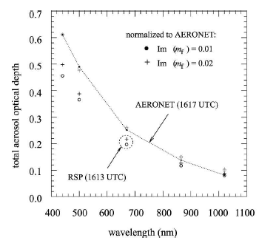
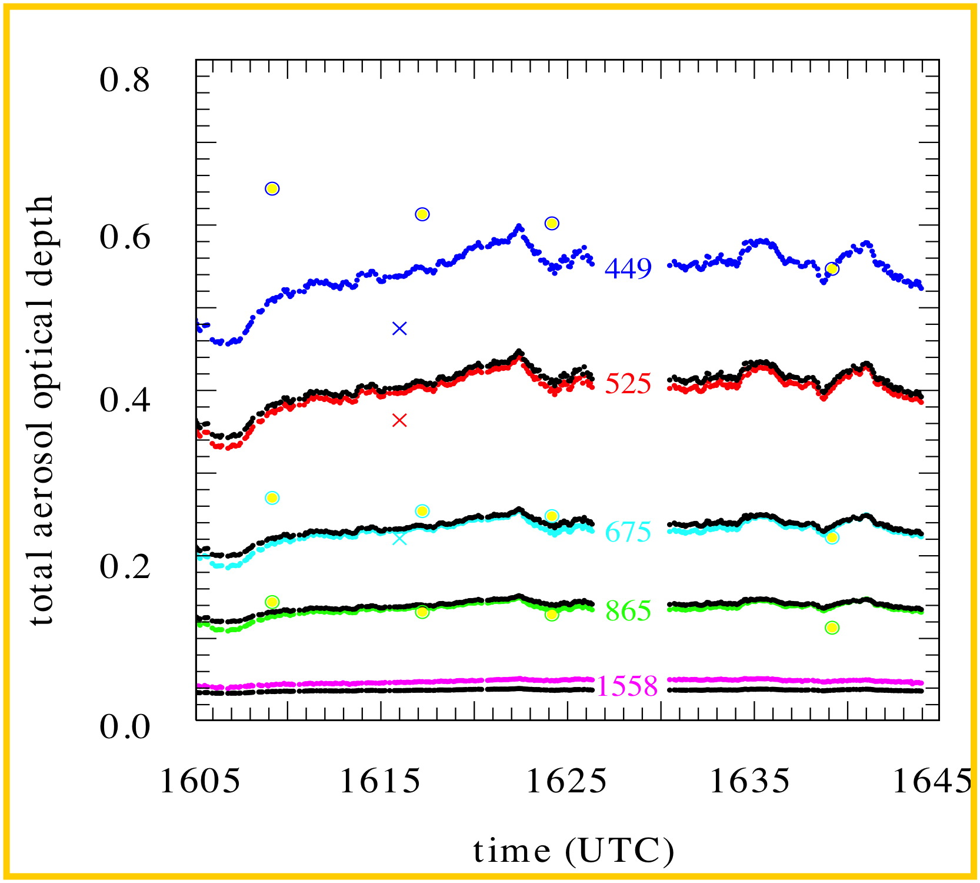
Aerosols
Over ocean
CLAMS field experiment
Chowdhary et al. (JAS, 2002), AGU 2007
†
†
τ(0.55 μm)
†
Fine mode
r_{e}
v_{e}
z_{bot}
z_{top}
m(0.55 μm)
σ_{ext}
RSP aerosol
.15
.2
0.0−2.7 km
3.6 km
1.45 –.015(±.005)i
.28(±.015)
.042(±.002)
†
†
in μm
†
in μm²
Left: AERONET data (dotted line) and RSP retrievals (circles and plusses) of aerosol optical depth AOD). Right: AOD spectral and spatial variation obtained from CV-580 aircraft (gray dots) compared with RSP retrievals (crosses). Shown also in both panels are RSP retrievals whose fine mode AOD are normalized (after subtracting spherical coarse mode AOD) to fit AOD data at shortest wavelength.
Notes:
Top: Table shows similar optical depth retrievals for RSP and MODIS fine aerosol, but large difference in extinction cross section. This leads to large difference in particle number concentration
Bottom: left panel shows that the spectrum of RSP fine aerosol mode agrees well with AERONET data for wavelengths smaller or equal to 865 nm. This implies correct fine mode size distribution. Right panel shows same agreement with AATS data. Note also for this panel that RSP underestimates AOD at1558 nm, which is consistent with use of spherical shape for coarse mode analyses in this particular study.

Slide 18
Aerosols
Over ocean
MILAGRO field experiment
Chowdhary et al. (RSE, 2011)
†
v_{e}
‡
‡
RSP aerosols
r_{e}
m(λ = 0.55 μm)
m(λ = 2.25 μm)
τ(λ = 0.55 μm)
τ(λ = 2.25 μm)
Fine mode
0.15
0.1
1.45 –.01i
1.40 –.01i
0.129
0.00225
†
†
2.0
1.0
1.39 –.0005i
0.085
0.074
Coarse mode
1.45 –.0005i
†
†
‡
in μm
†
for RSP file 53
equi-probable aspect ratio distribution
March 10, 2006
τ_{coarse} = 0.072, τ_{fine} = 0.235
RSP file 44
410 nm
shadow
Altitude:
62 m
550 nm
Sun angle:
31°
Azimuth angle:
1.3°
Total reflectance
sun glint
Time (UTC):
19 hr 54 m
Polarized reflectance
Black ocean body
RSP file 53:
[Chl] = 0.03 mg/m³
Altitude:
4.1 km
[Chl] = 0.10 mg/m³
Sun angle:
39°
865 nm
[Chl] = 0.30 mg/m³
Azimuth angle:
3.8°
2250 nm
410 nm
[Chl] = 1.00 mg/m³
Time (UTC):
20 hr 36 m
Chlorophyll a:
0.1 mg/m³
view angle
view angle
Notes:
Top: Table shows fine mode aerosol and non-spherical coarse mode aerosol properties retrieved from RSP data during MILAGRO campaign in 2006
Bottom: left graph shows 410 nm total reflectance observed by RSP in principal plane at low altitude, and the corresponding fit with our ocean model. Left graph shows polarized reflectance observed in principal plane at high altitude, and the corresponding fits with aerosol specified in top Table.

Slide 19
Aerosols
Over ocean
MILAGRO field experiment
Chowdhary et al. (RSE, 2011)
†
v_{e}
‡
‡
RSP aerosols
r_{e}
m(λ = 0.55 μm)
m(λ = 2.25 μm)
τ(λ = 0.55 μm)
τ(λ = 2.25 μm)
Fine mode
0.15
0.1
1.45 –.01i
1.40 –.01i
0.129
0.00225
†
†
2.0
1.0
1.39 –.0005i
0.085
0.074
Coarse mode
1.45 –.0005i
†
†
‡
in μm
†
for RSP file 53
equi-probable aspect ratio distribution
March 10, 2006
RSP file 44
Altitude:
62 m
Sun angle:
31°
Aerosol optical thickness
Azimuth angle:
1.3°
Aerosol optical thickness
Time (UTC):
19 hr 54 m
RSP file 45:
RSP file 53 AOD
Altitude:
68 m
Sun angle:
33°
RSP file 53 AOD
Azimuth angle:
38°
Time (UTC):
20 hr 02 m
Wavelength
RSP file 53:
Wavelength
Altitude:
4.1 km
Time (UTC):
20 hr 36 m
Notes:
Top: Table shows fine mode aerosol and non-spherical coarse mode aerosol properties retrieved from RSP data during MILAGRO campaign in 2006
Bottom: left graph shows AOD for RSP file 44 compared with AOD from AATS and from RSP file 53. Right graph shows same except for RSP file 45.

Slide 20
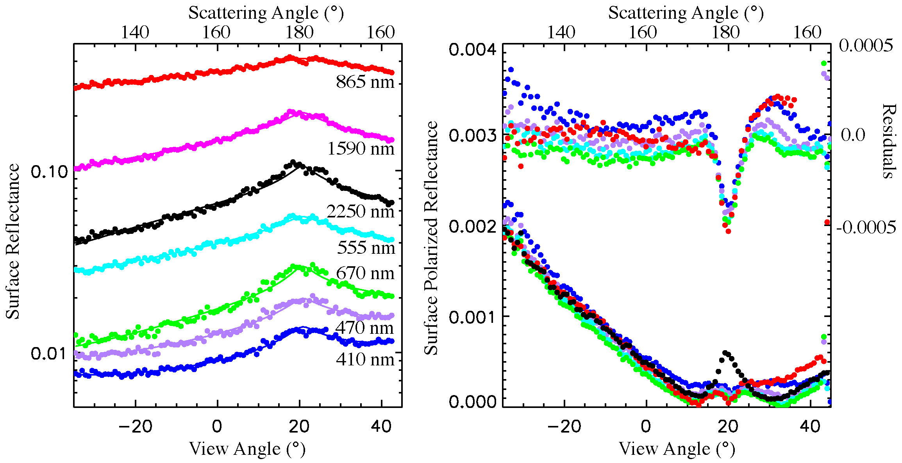
Aerosols
Over Land
Main “feature” differentiating aerosol retrievals over land and ocean is the much larger dynamic range in the magnitude and spectral variations in the surface reflectance over land.
  Aircraft can fly low over land surfaces such as the Dismal Swamp and Mexico City to safely characterize surface properties while minimizing atmospheric correction issues.
DISMAL SWAMP

Slide 21
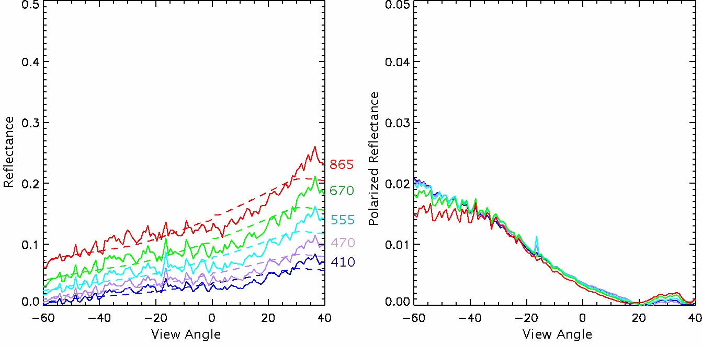
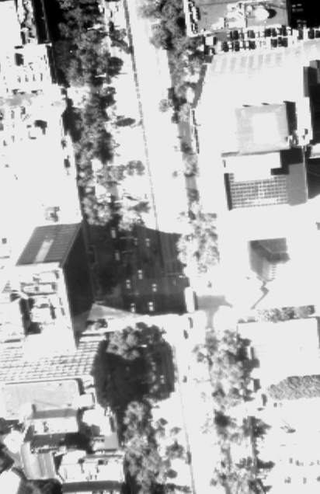
Aerosols
Over Land
Similarities between Mexico City and Dismal Swamp
  BRDF shape dominated by shadowing for both with peak at backscatter where there are no visible shadows (trees in one case, buildings in the other).
  Polarized reflectance grey in both cases
  Completely different color
  Current RSP retrieval use polarized reflectance and short wave reflectance
Backscatter
Backscatter

Slide 22
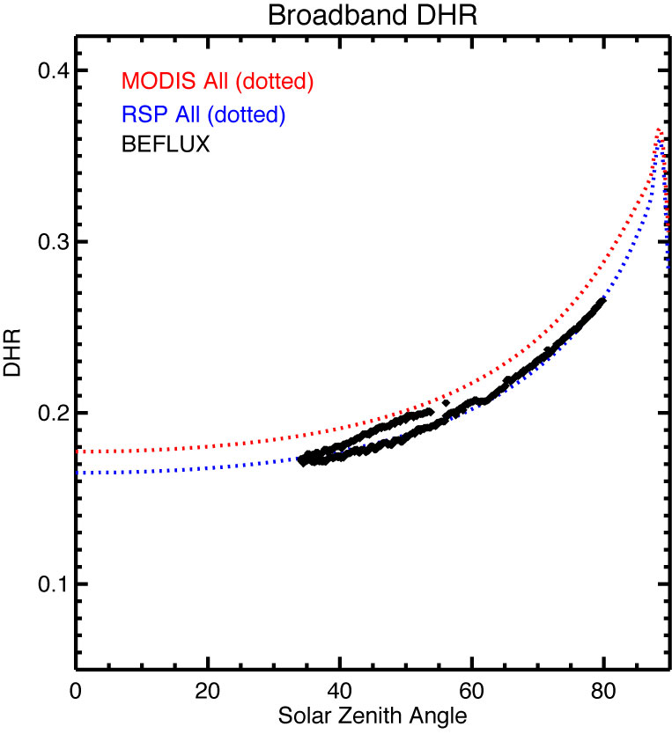
Aerosols
Over Land
Evaluation of surface BRDF estimates at SGP
  As noted by Hasekamp and Dubovik surface/aerosol retrievals over land allow for the multi-angle, multi-spectral reflectance to be accurately estimated instantaneously using an RPV, or kernel surface BRDF estimate.
  The retrieved BRDF and spectral coverage of the APS facilitate good estimates of the surface DHR as a function of solar zenith angle and of the BHR instantaneously.

Slide 23
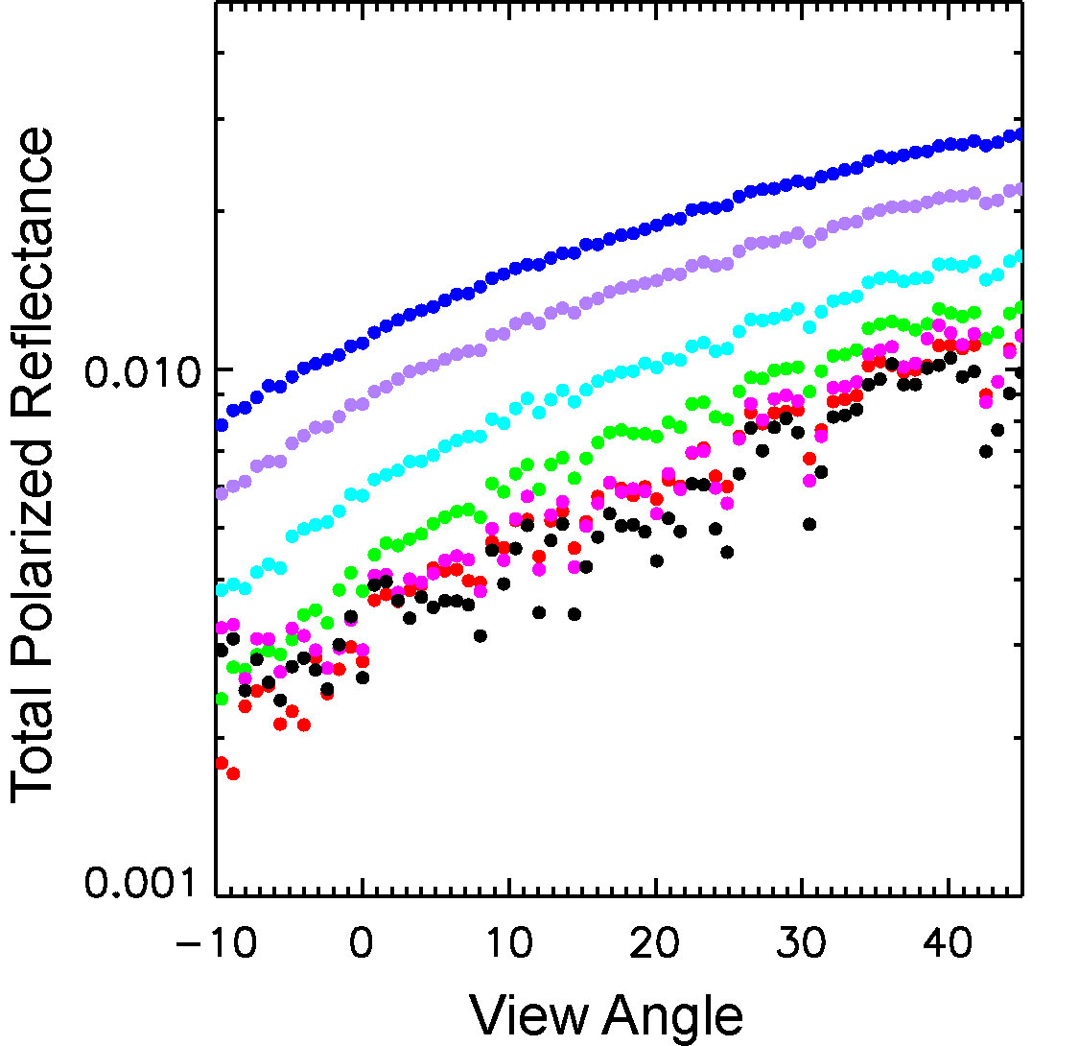
Aerosols
Over Land
Surface contrast causes the angular signature of total polarized reflectance to be rough.
Since surface polarized reflectance is grey use 2250 nm measurements as a proxy.
Determine aerosol optical depth by requiring that atmospheric polarized reflectance be smooth.
Figure shows RSP measurements of polarized reflectance at 410, 470, 555, 670, 865, 1590 and 2250 nm (blue, mauve, turquoise, green, purple and black) close to the solar principal plane at a solar zenith angle of 55°.
Note that fluctuations are coherent across all spectral bands. They are caused by surface polarized reflectance variations.
Atmospheric polarized reflectance contribution is smooth, so use this to separate out the atmospheric and surface effects.
ISSSR 2003: Session H. Sensor Systems
RSP and Airborne Applications

Slide 24
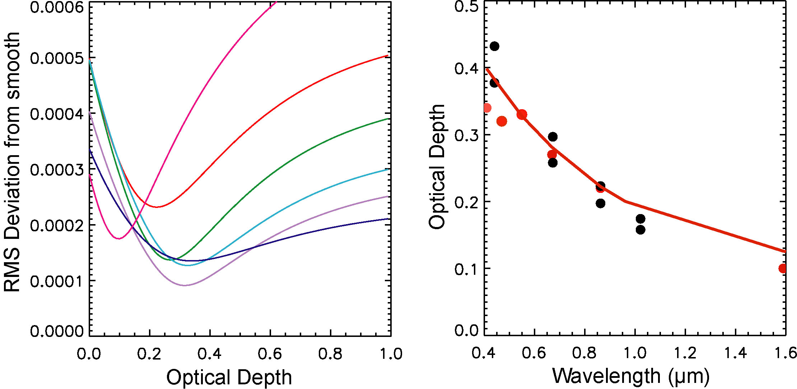
Aerosols
Over Land
Use deviation from smoothness as criteria for determination of optical depth. Left figure shows variation in smoothness as a function of aerosol optical depth for the RSP bands at 410, 470, 555, 670, 865, 1590.
Even this very simple method for estimating aerosol optical depth is very effective for all except the shortest wavelength bands.
Right hand figure shows simple aerosol optical depth estimates from RSP measurements as red symbols. More detailed analysis yields the aerosol optical depths shown by the red line.
CIMEL measurements at JPL thirty minutes before and after the RSP measurements are shown as black symbols.
ISSSR 2003: Session H. Sensor Systems
RSP and Airborne Applications

Slide 25
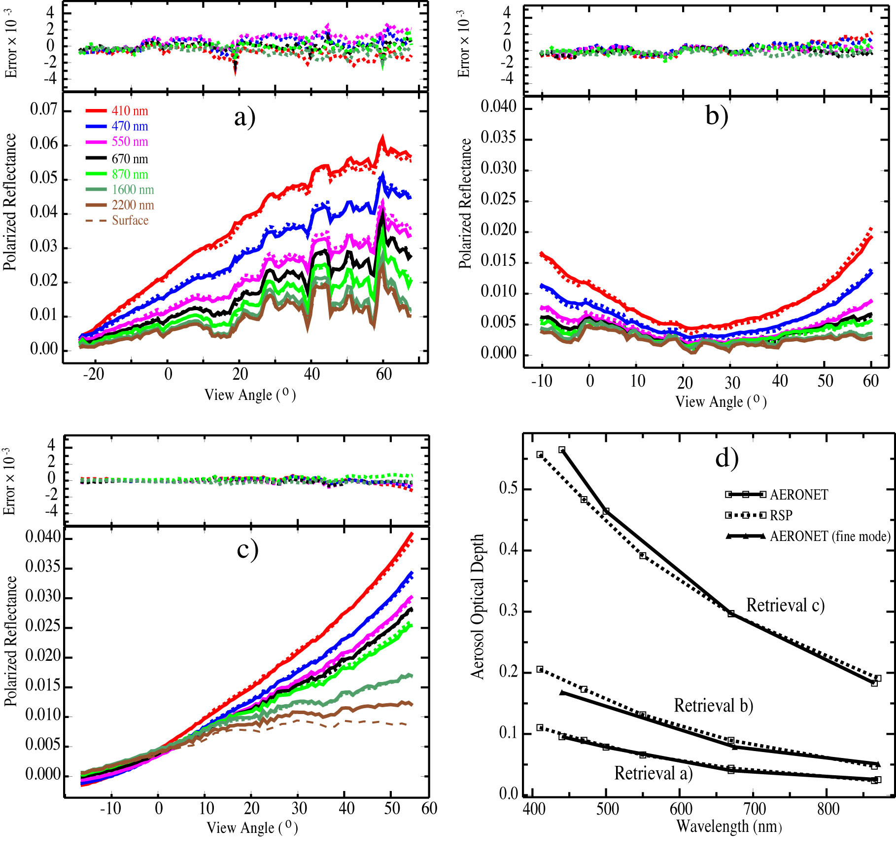
Aerosols
Over Land
Polarization is sensitive to the aerosol load over land, even over urban areas (c, Mexico City).
Not only can the aerosol burden be identified, but the spectral and angular signature in the polarized reflectance is sensitive to the complex refractive index (1.54 + i 0.027) and the single scattering albedo (0.865).
These retrieval examples are over an effective “pixel” size of 10 km since the multiple views are instantaneous and are NOT aggregated to the same point at the surface.

Slide 26
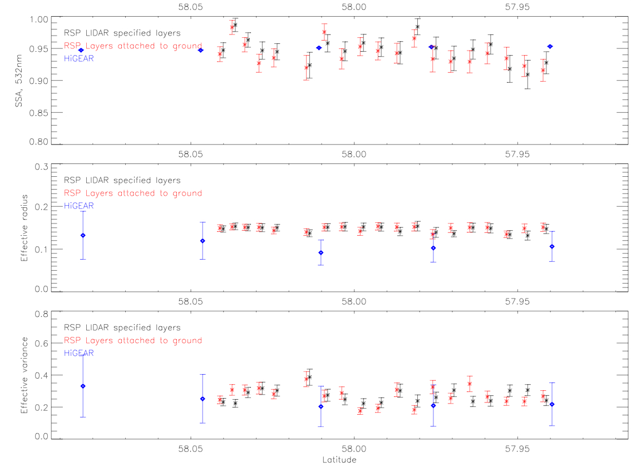
Aerosols
Over Land
  In ARCTAS co-ordination between NASA P-3 and NASA B200 provided good in situ comparisons for retrievals.

Slide 27
Clouds

Slide 28
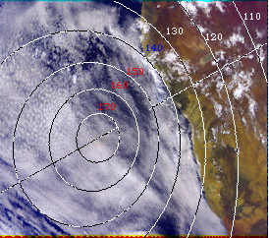
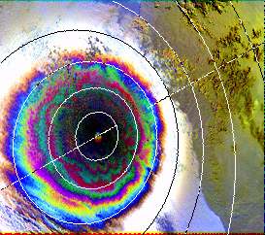
Clouds
Water Clouds
Two methods to get droplet size:
  Rainbow and absorbing band method (Nakajima, King, Platnick etc.) using 1.6 and 2.26 µm
Stratocumulus
over the ocean
Scattering Angle
Africa
Color composite 443-670-865 nm
Same scene in polarised light
Bréon, François-Marie, LSCE, France

Slide 29
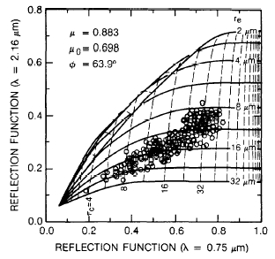
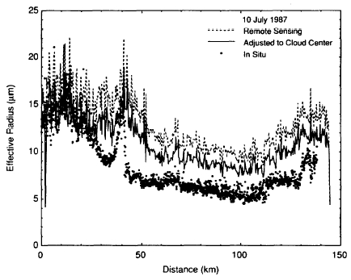
Clouds
Water Clouds
Two methods to get droplet size:
  Rainbow and absorbing band method (Nakajima, King, Platnick etc.) using 1.6 and 2.26 µm
Nakajima and King, JAS, 1990.

Slide 30
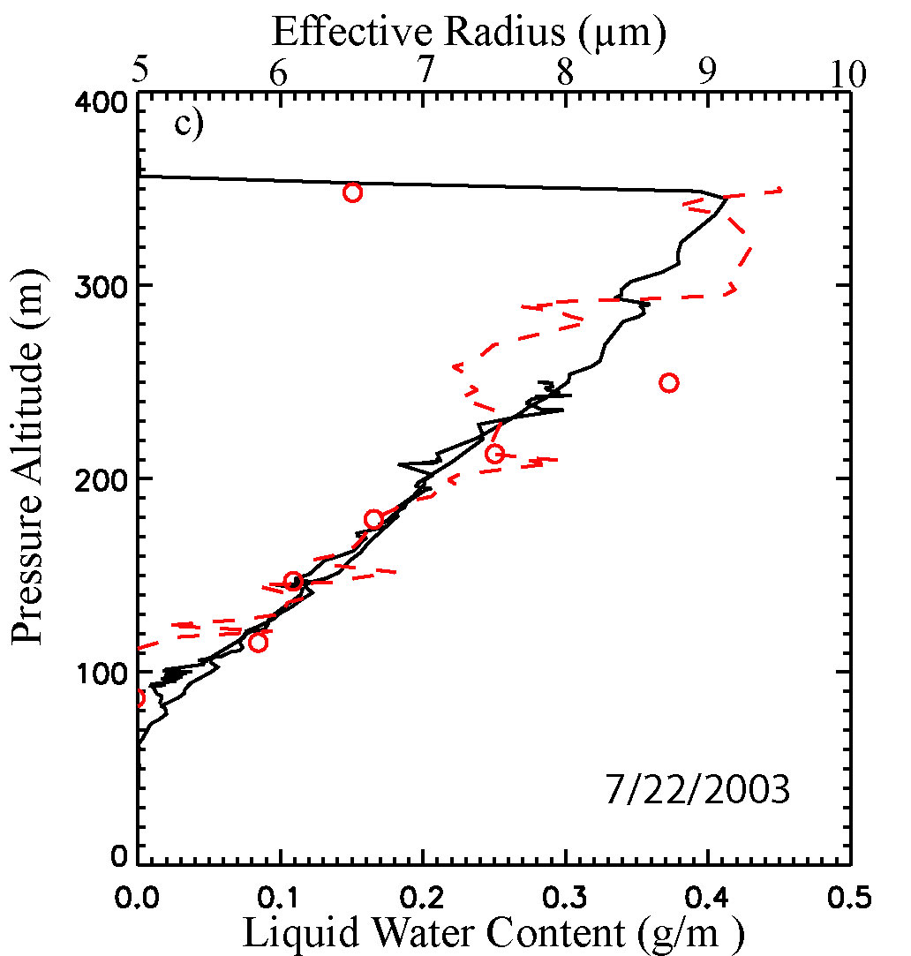
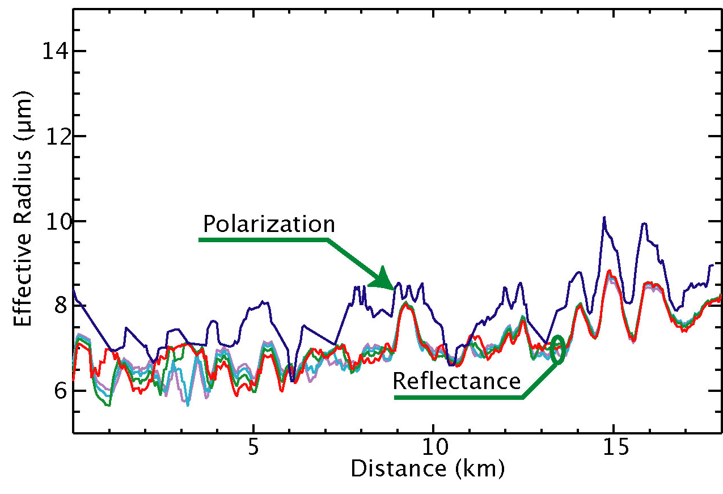
Clouds
Water Clouds
The two methods generally get different sizes
  Polarization size retrieval is usually larger than the absorbing band retrieval

Slide 31
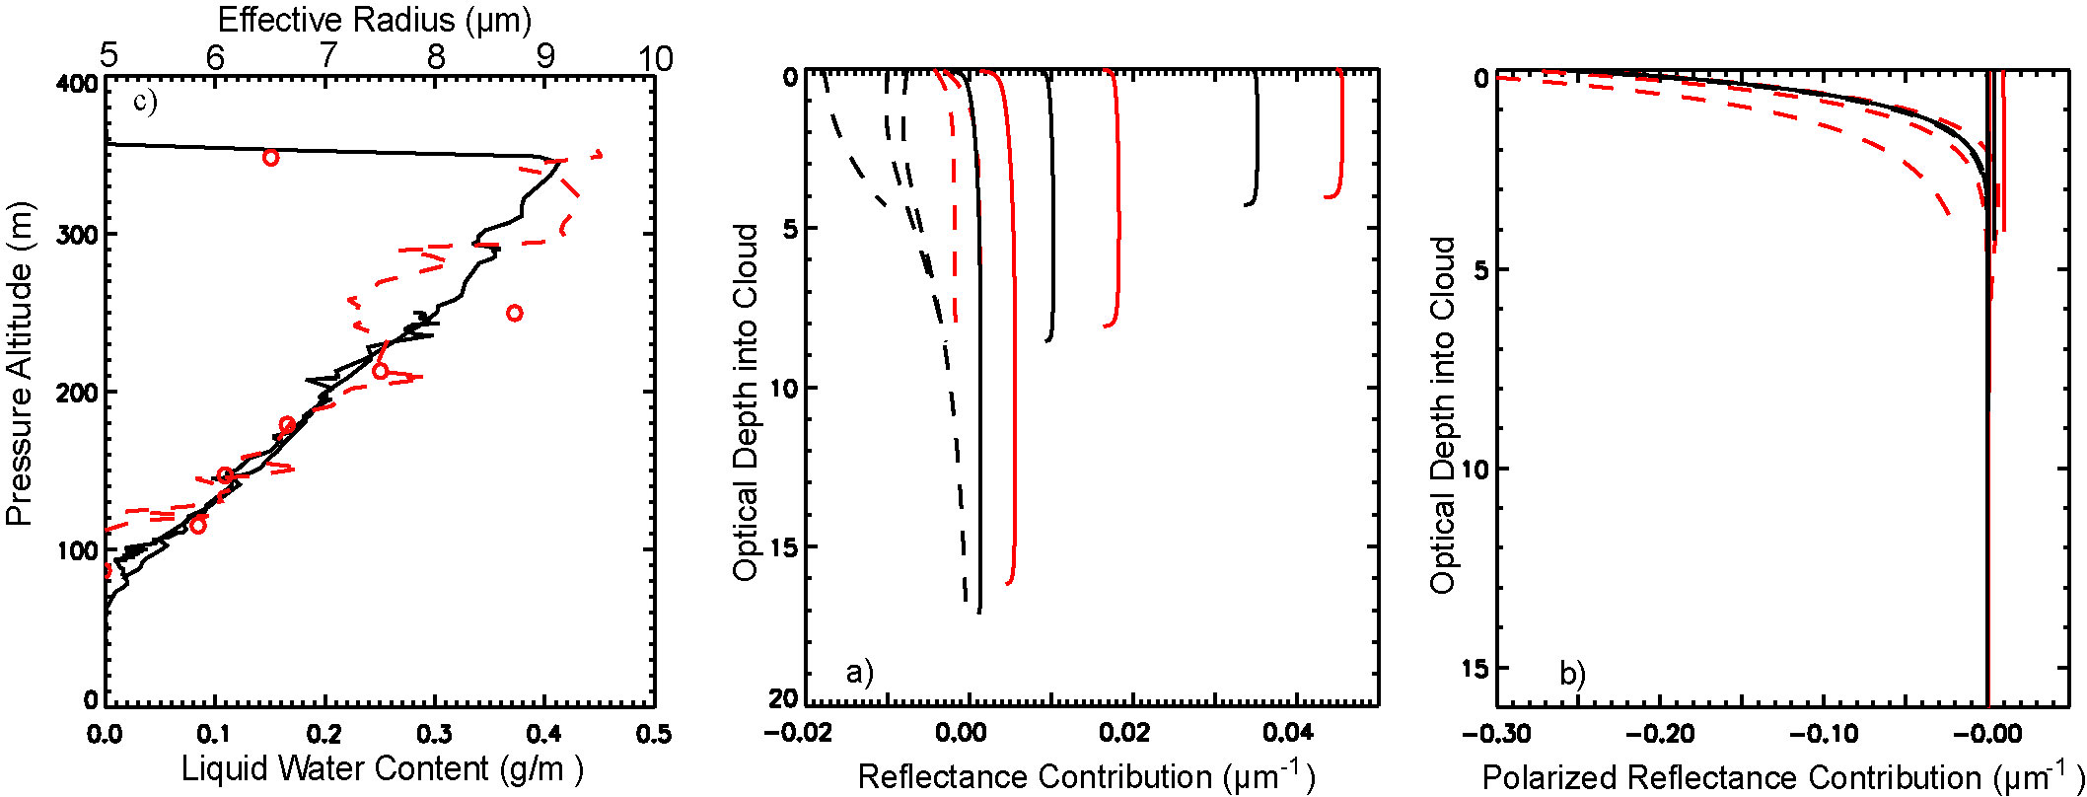
Clouds
Water Clouds
Size differences caused by different vertical sensitivities
  Consistent with observed profile variations and weighting functions
Comparison of in situ (FSSP) and polarimetric (RSP) estimates of cloud droplet size on 07/25/2003 (top) and 07/22/2003 (bottom).
The RSP “top” estimate uses polarized reflectance and the “wgt” estimate uses reflectance measurements.
The FSSP measurements are weighted for comparison. OD agreement is much better than the uncertainty in its determination.

Slide 32
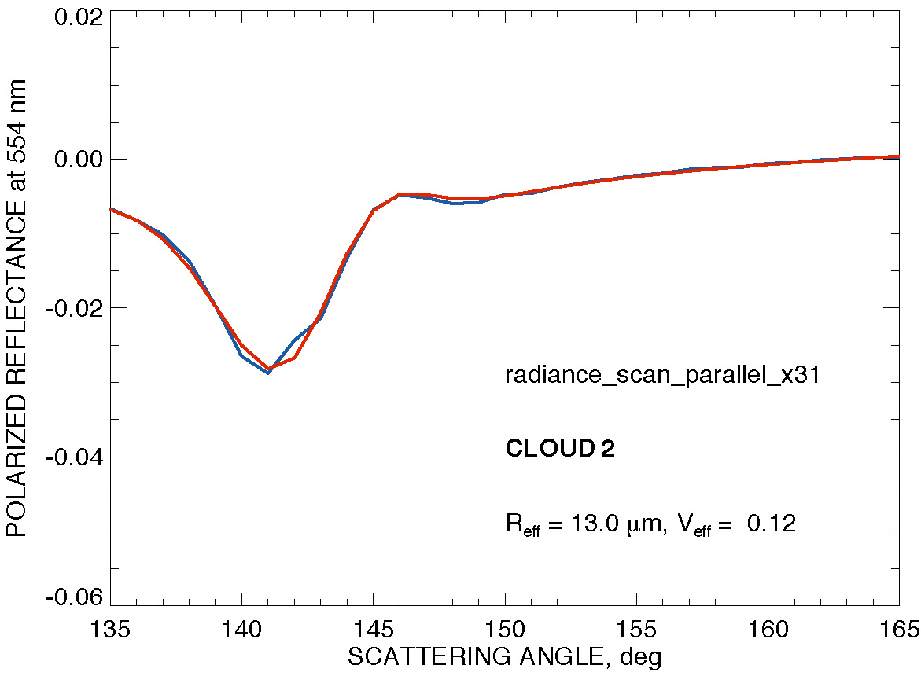
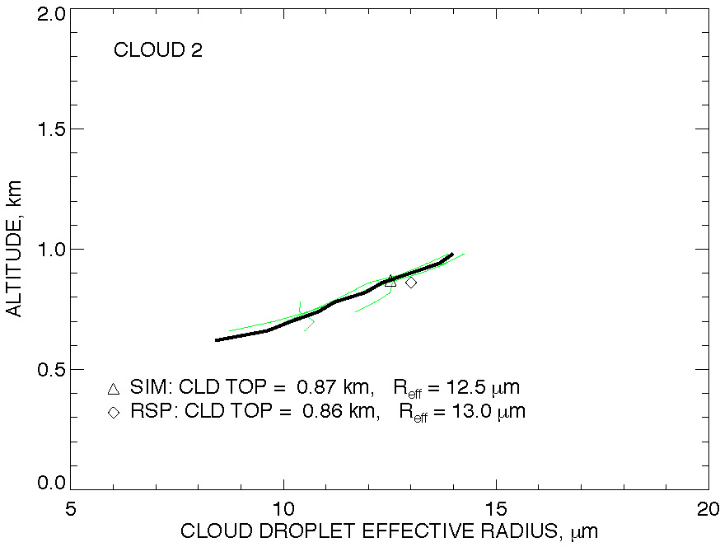
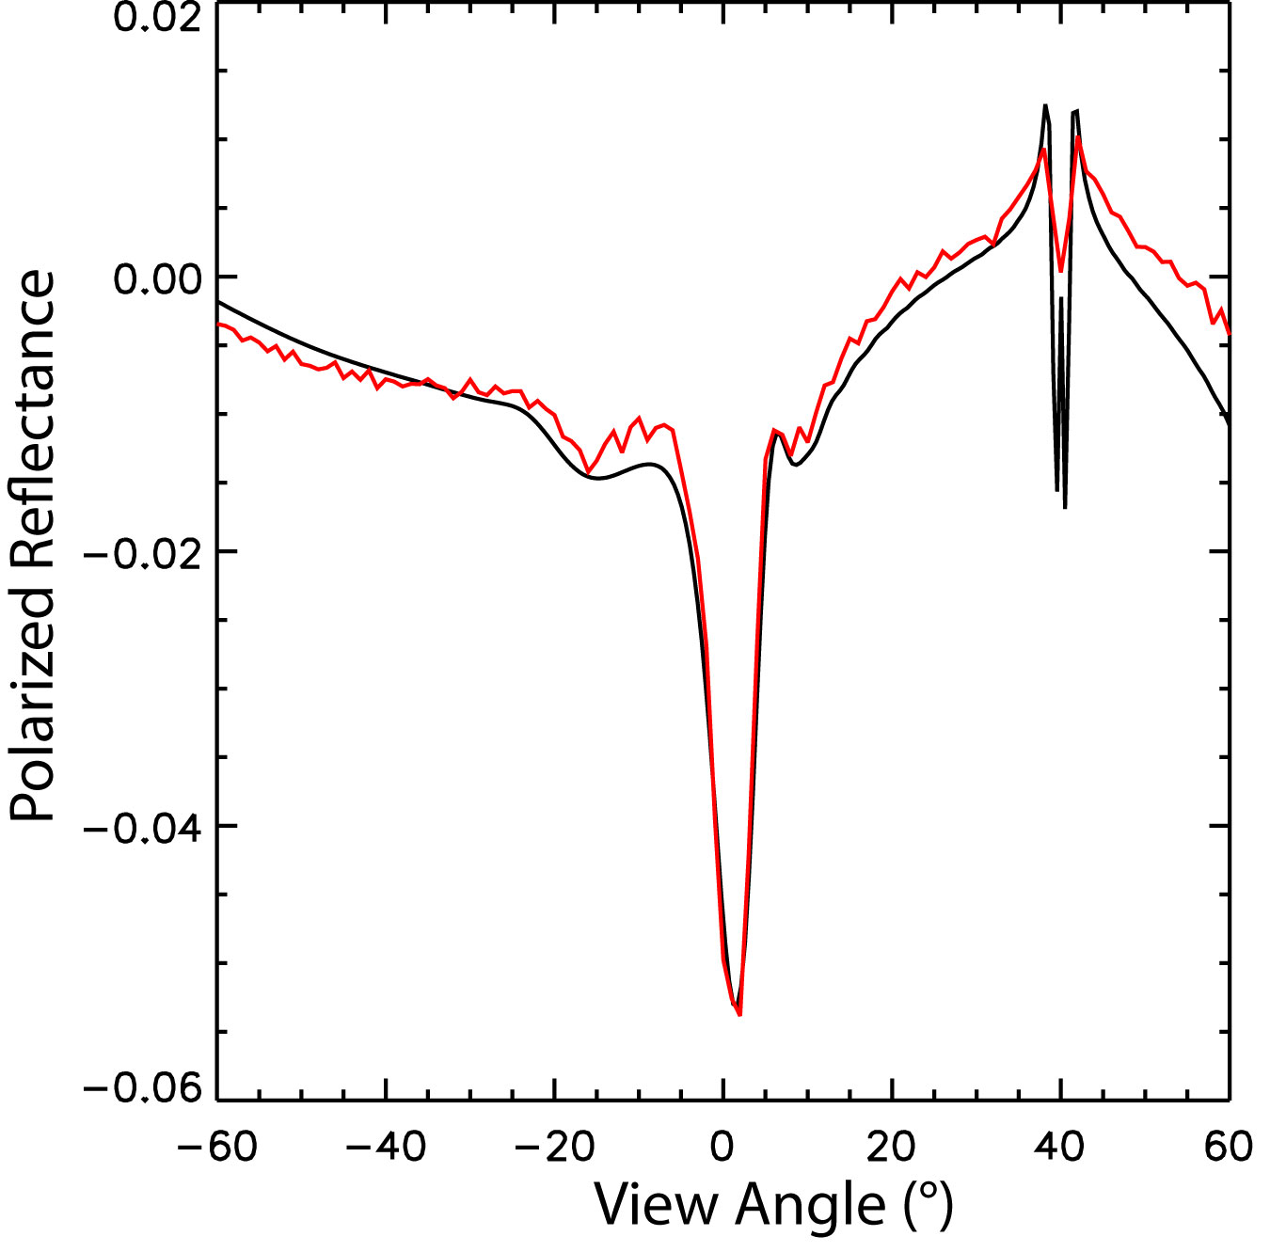
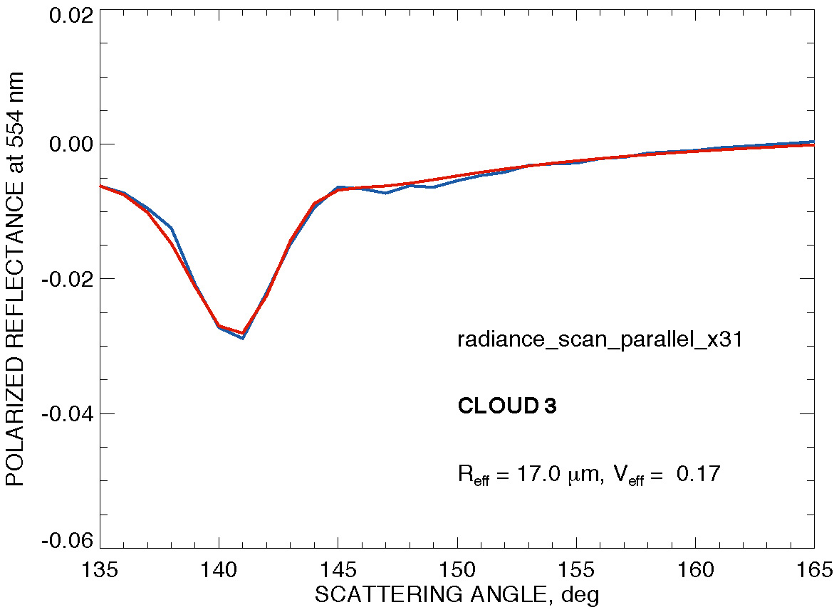
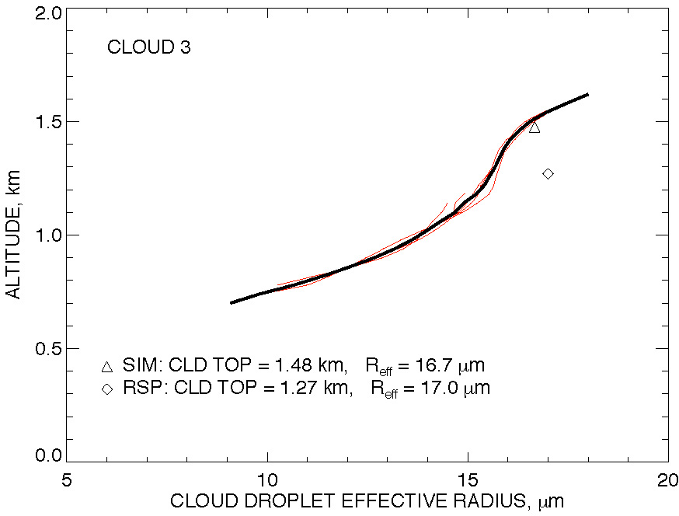
Clouds
Water Clouds
Polarization size retrievals are not affected by 3D radiative transfer
  Polarized radiance simulations for RICO cloud field (Ackerman) using MC code (Emde)
3D effects exist, they just don’t affect the structure of the rainbow.
For example the red line above is the MC calculation and the black line is a plane parallel calculation for the same column scaled by 1.5.
RSP fit
R_{eff} profile

Slide 33
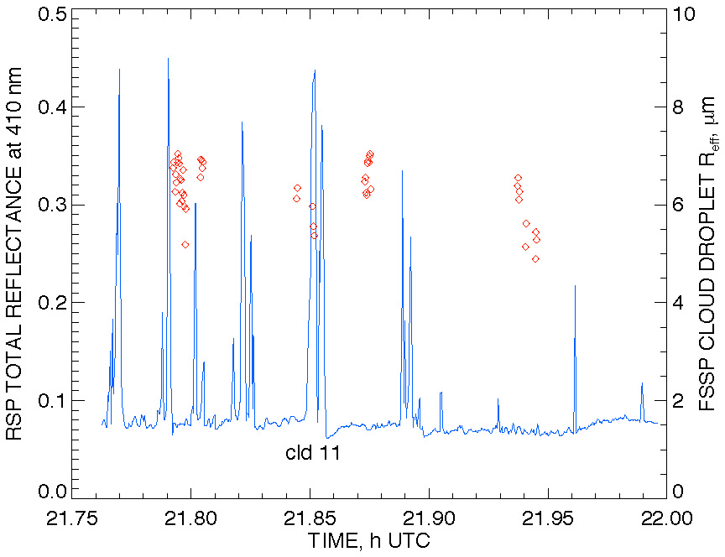
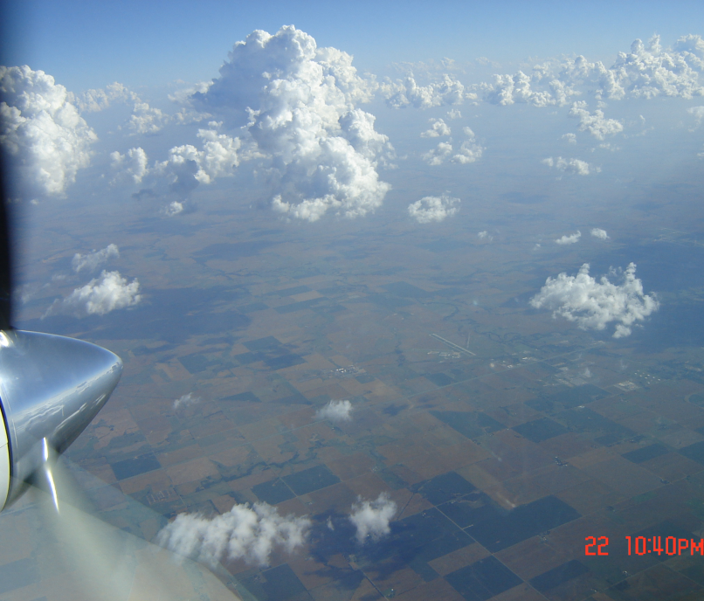
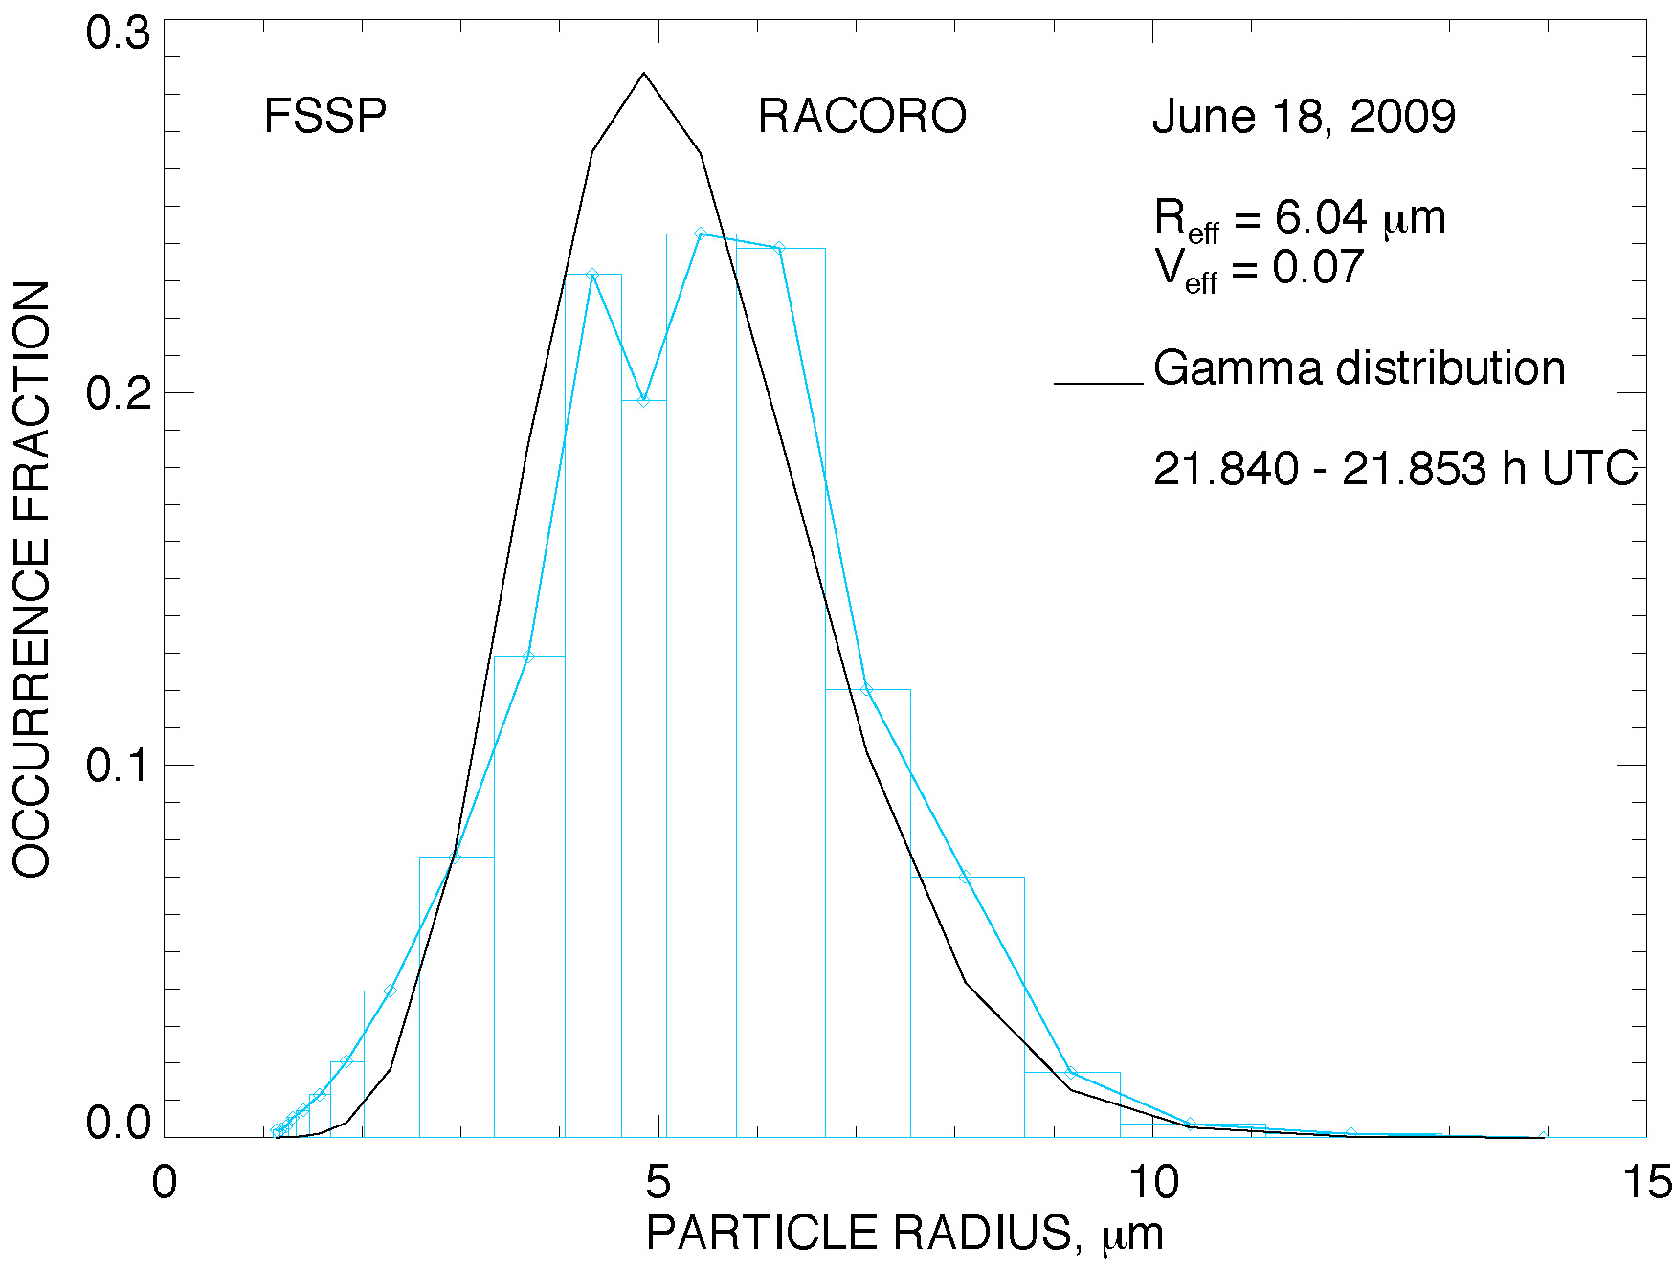
Clouds
Water Clouds
Polarization size retrievals are not affected by 3D radiative transfer
  Measurements during RACORO
FSSP R_{eff}
Cld 11
R_{eff} = 6.04 μm
V_{eff} = 0.07
R_{eff} = 6.5 μm
V_{eff} = 0.03

Slide 34
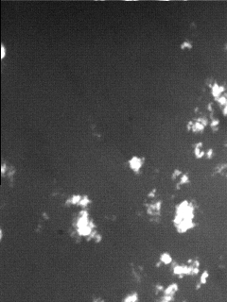
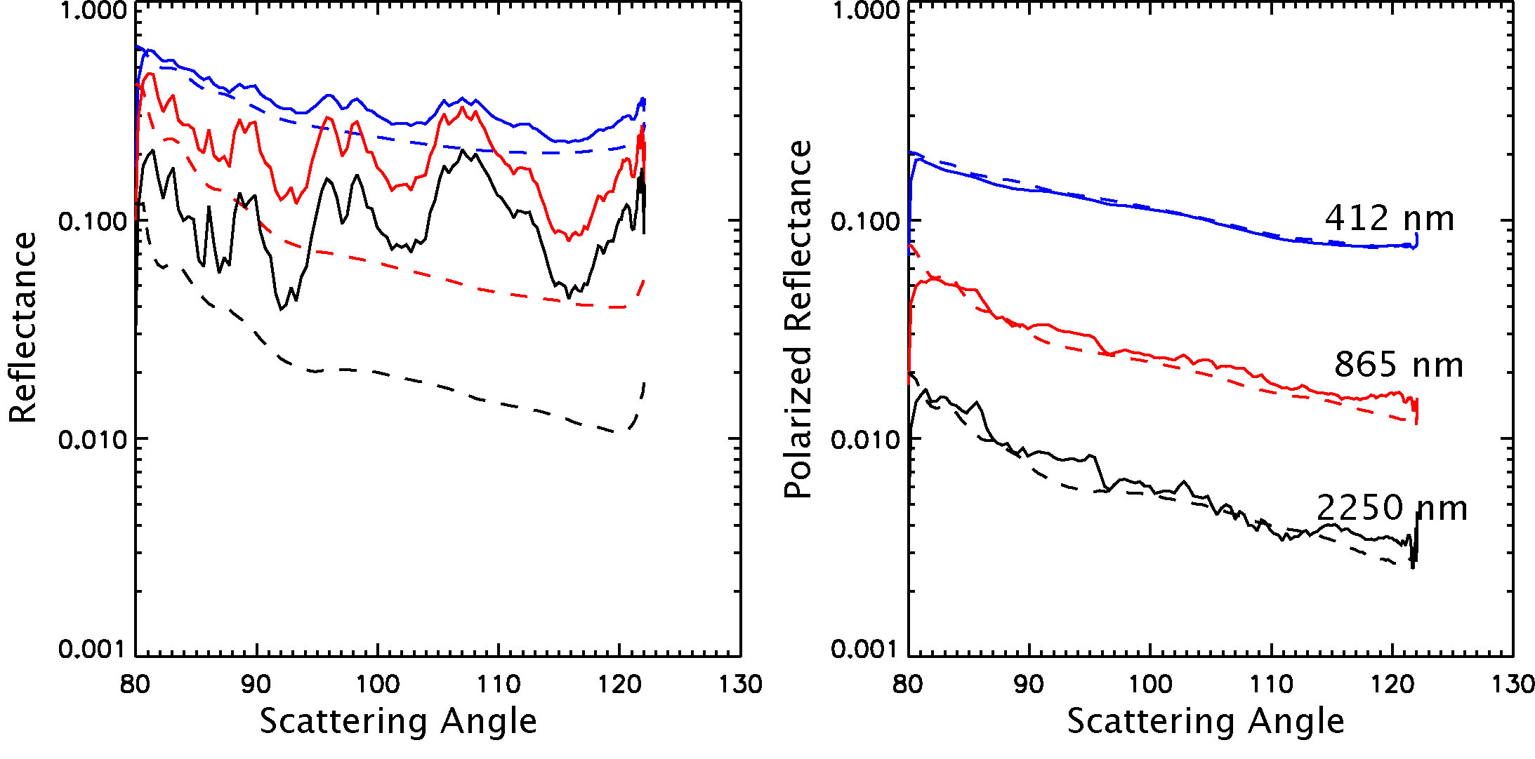
Clouds
Water Clouds
Aerosols above clouds
Intensity reflected by clouds is bright compared to aerosols
Dashed line from clear scene, solid from broken cloud.
Away from the rainbow the polarization of clouds is small.
Clouds are black! - polarimetrically speaking. This is what allows polarization observations to be used to perform aerosol retrievals above clouds, or in broken cloud fields.

Slide 35
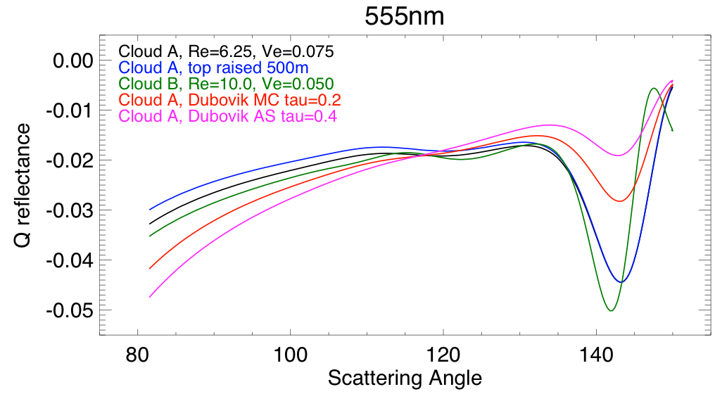
Clouds
Water Clouds
Aerosols above clouds
Polarized observations can distinguish aerosol and cloud optical properties and are insensitive to cloud optical depth (above ~3)

Slide 36
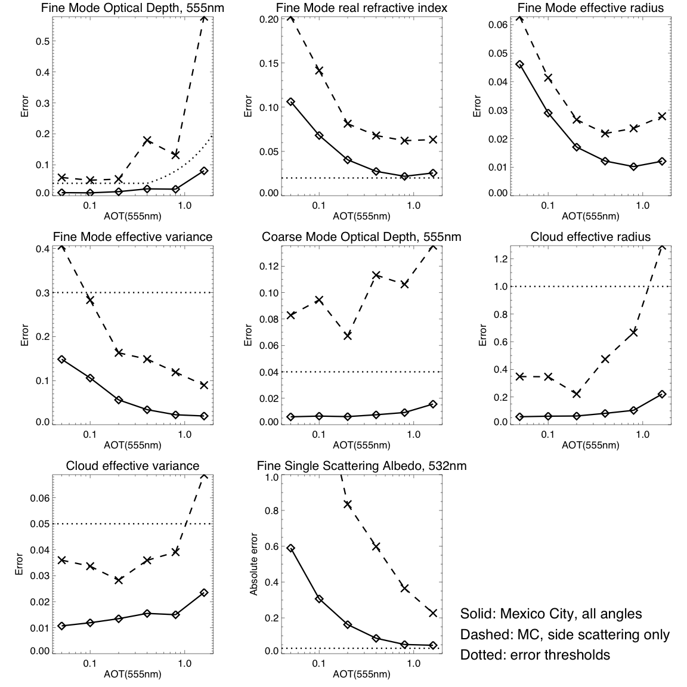
Clouds
Water Clouds
Aerosols above clouds
Simulations can be used to assess sensitivity using the Jacobian

Slide 37
Clouds
Water Clouds
Aerosols above clouds
Simulations can be used to assess sensitivity using the Jacobian

Slide 38
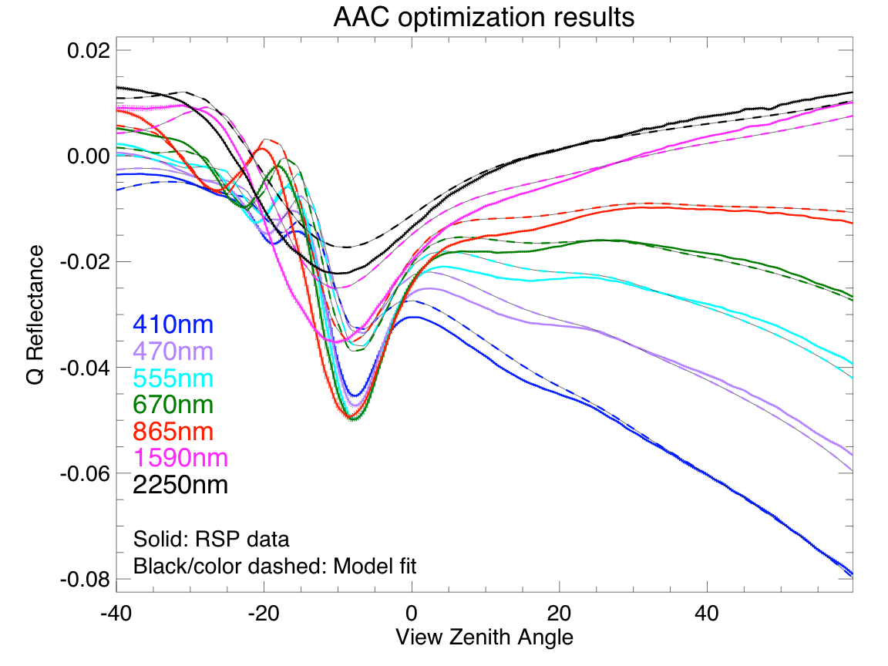
Clouds
Water Clouds
Aerosols above clouds
  Assumptions
    Cloud: Uniform size distribution, infinite optical depth, top at 500m
    Aerosol: uniformly distributed between 600 and 1800m, two parameter model for imaginary refractive index, aerosols are spheres

Slide 39
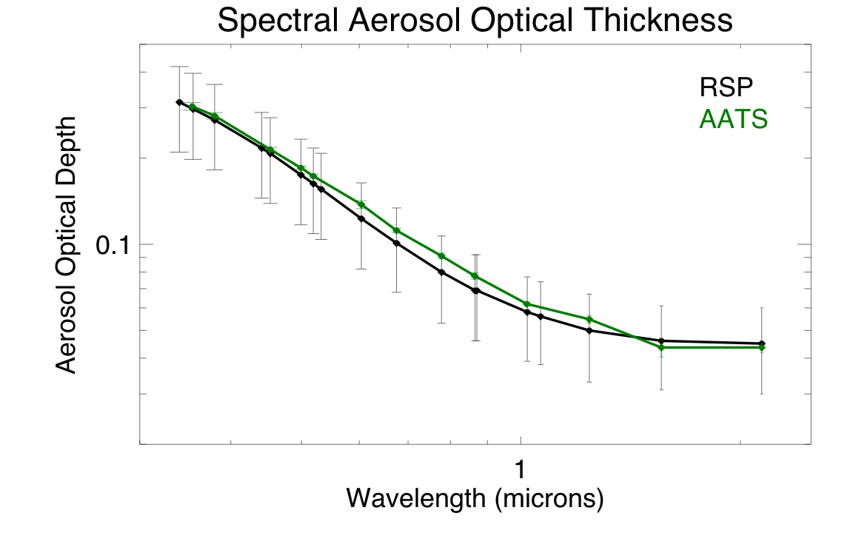
Clouds
Water Clouds
Aerosols above clouds
  Results compare well to AATS sun photometer

Slide 40
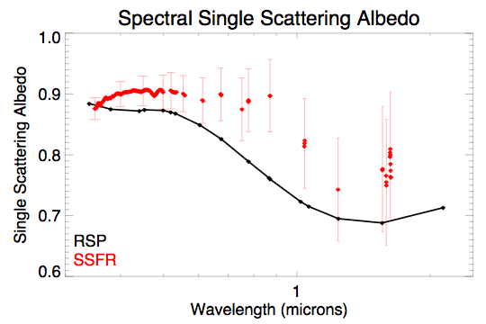
Clouds
Water Clouds
Aerosols above clouds
  Large uncertainty but reasonable comparison to Solar Spectral Flux Radiometer observations*
* R. W. Bergstrom, K. S. Schmidt, O. Coddington, P. Pilewskie, H. Guan, J. M. Livingston, J. Redemann, and P. B. Russell. Aerosol spectral absorption in the mexico city area: results from airborne measurements during milagro/intex b. Atmos. Chem. Phys., 10:6333–6343, 2010.

Slide 41
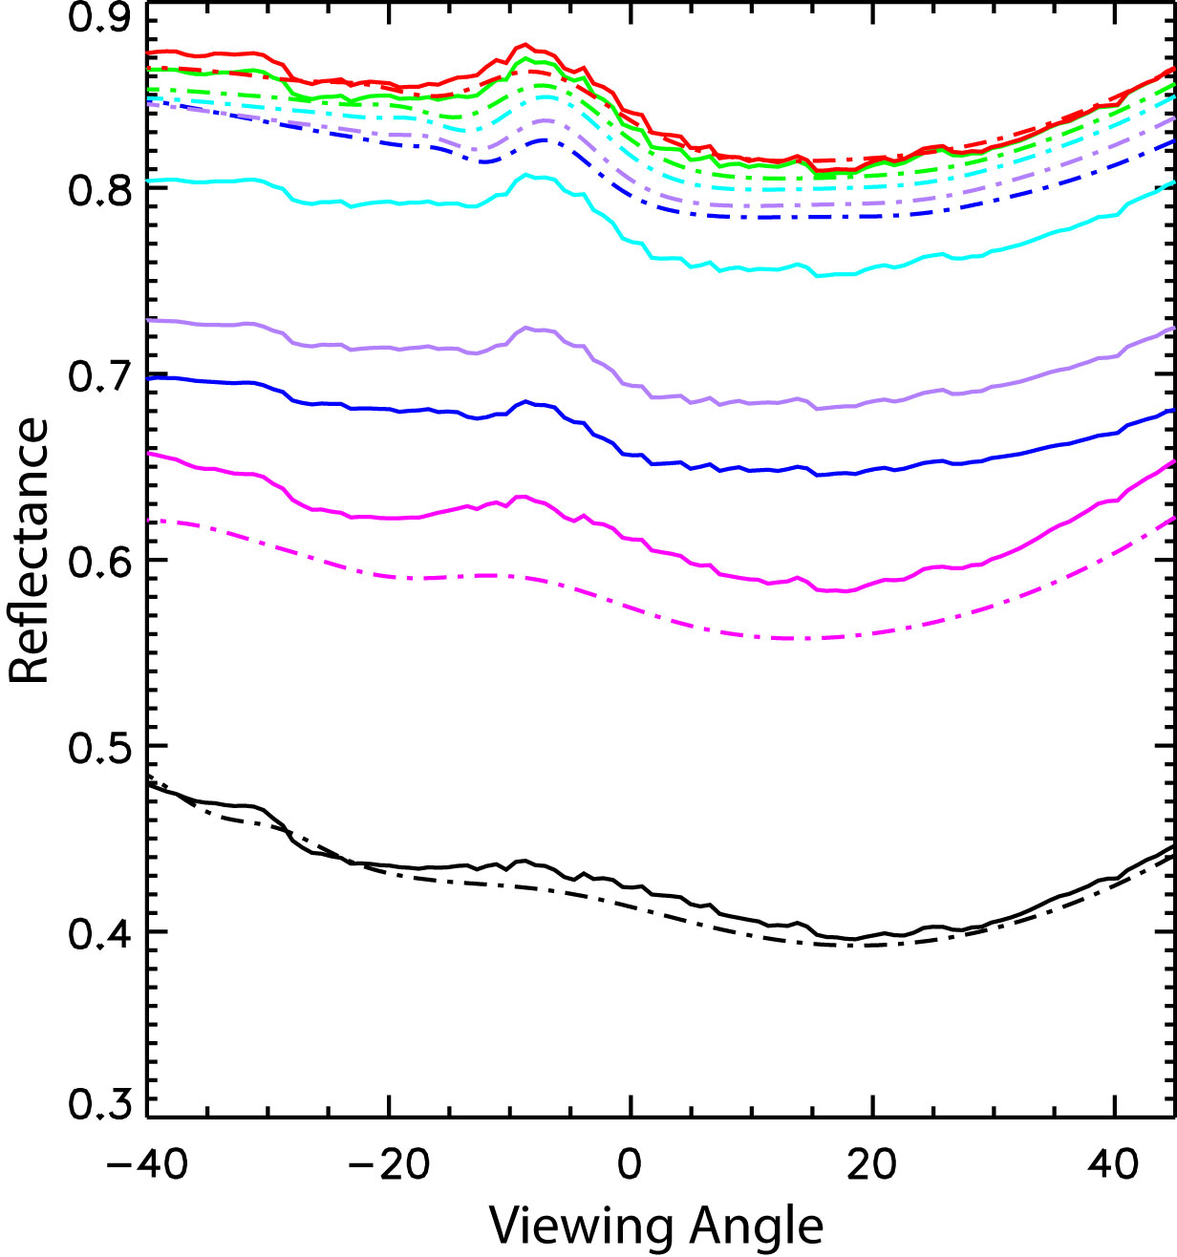
Clouds
Water Clouds
Aerosols above clouds
  Applying standard absorbing/non-absorbing band table look-up retrieval of optical depth and particle size to the cloud from MILAGRO gives large residual misfit (COT=50, r_{eff}=5.5 µm; @ top r_{eff}=7.02 µm, v_{eff}=0.029)
  Total AOT is only 0.15 at 550 nm

Slide 42
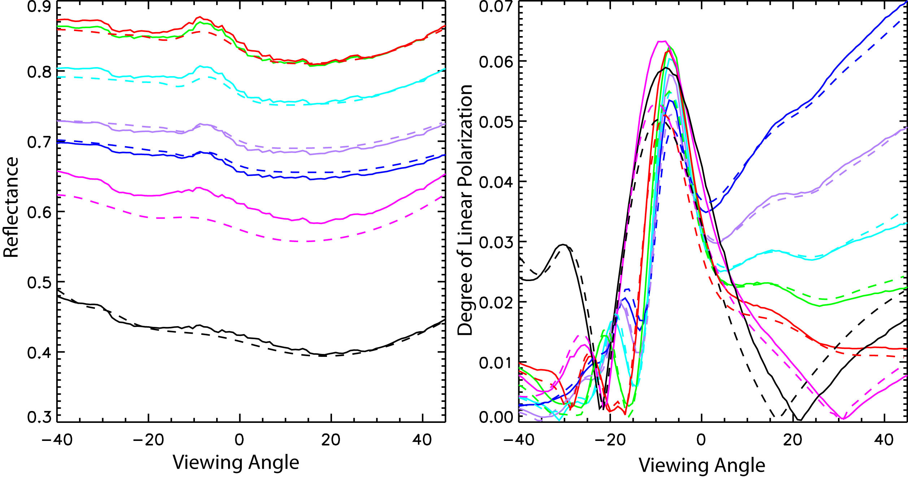
Clouds
Water Clouds
Aerosols above clouds
  Aerosol absorption is strongly constrained by reflectance and DoLP above bright clouds
  Uncertainties in optical depth and imaginary index reduced to 10% by using reflectance and DoLP

Slide 43
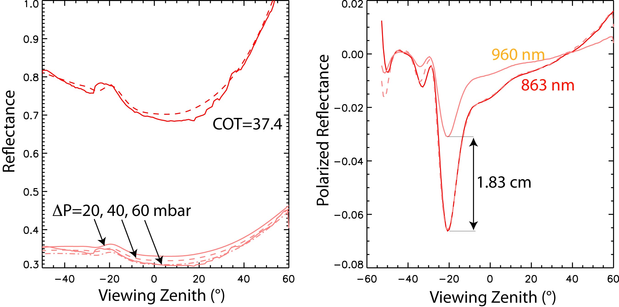
Clouds
Water Clouds
Water vapor in clouds/N_{d}
  Estimated 8 g/kg saturated mixing ratio, cloud top at 900 mbar, thickness 40±20 mbar, 9.6 µm size and COT of 37.4 gives N=185±75 cc⁻¹.
  Previous cloud thickness results from CLAMS on two days available were 30 mbar vs 30 mbar and 60 mbar vs 40 mbar

Slide 44
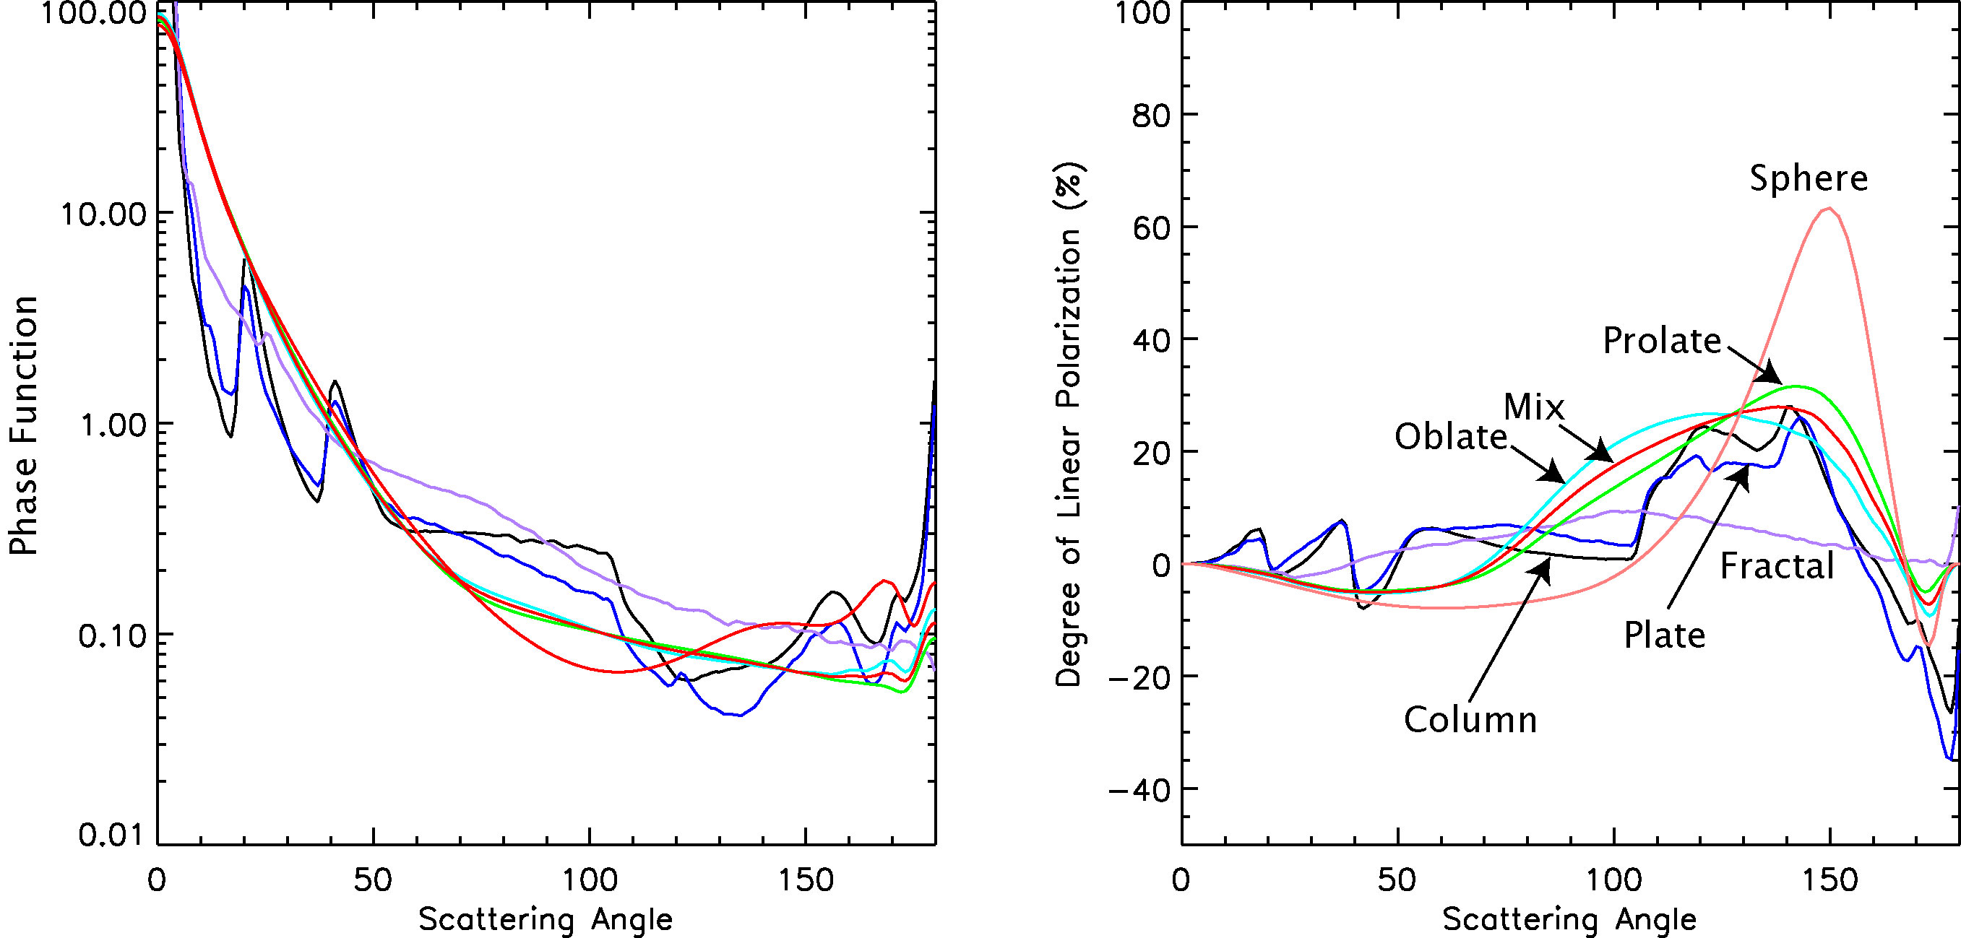
Clouds
Ice Clouds
Detection and remote sensing of ice clouds is important to ensure that aerosol retrievals are not being contaminated by thin cirrus clouds and to determine the radiative effects of these very cold clouds.
For people doing remote sensing the first thing to do when you come across an ice cloud is pick a phase function (crystal habit).

Slide 45
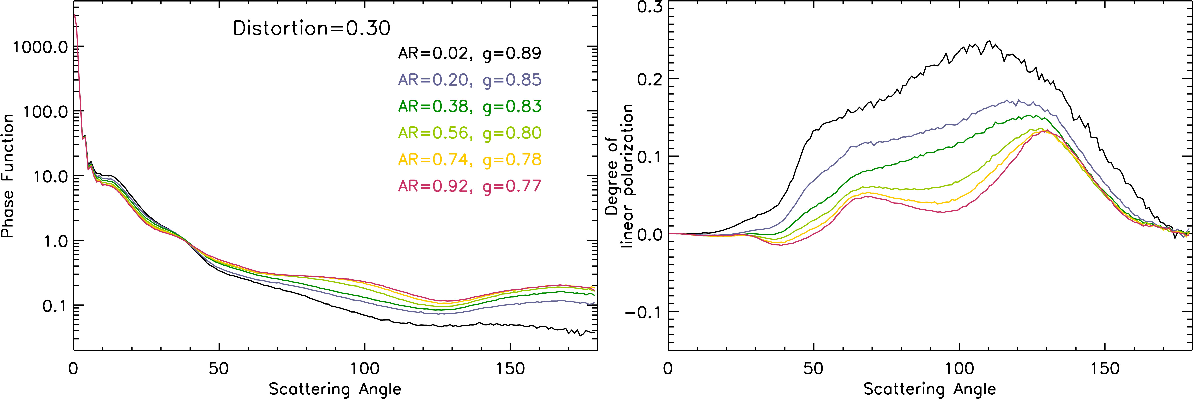
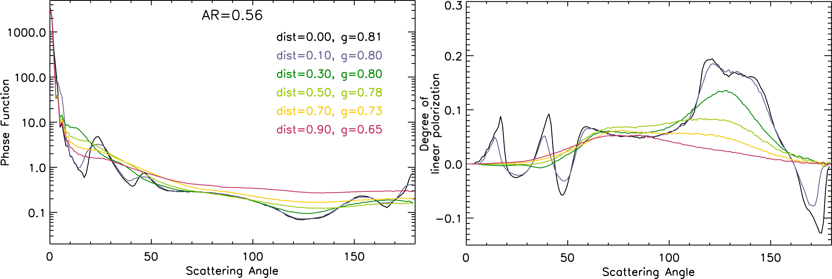
Clouds
Ice Clouds
Scattering properties are primarily determined by aspect ratio and roughness.
Retrievals now use scattering properties of hexagonal particles parameterized on aspect ratio and roughness.

Slide 46
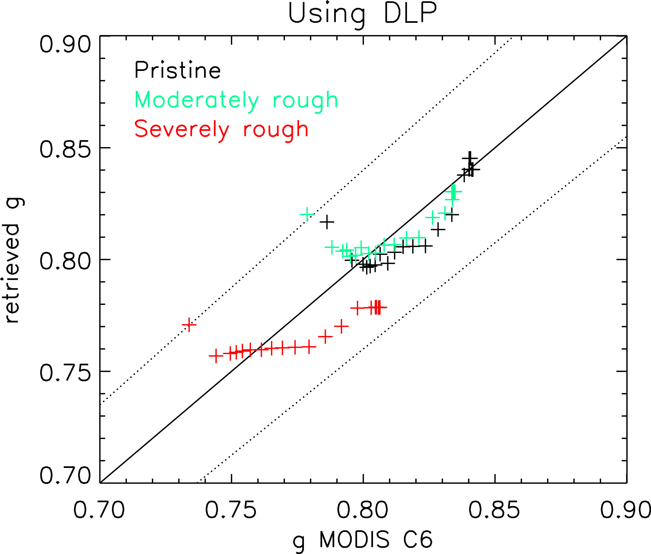
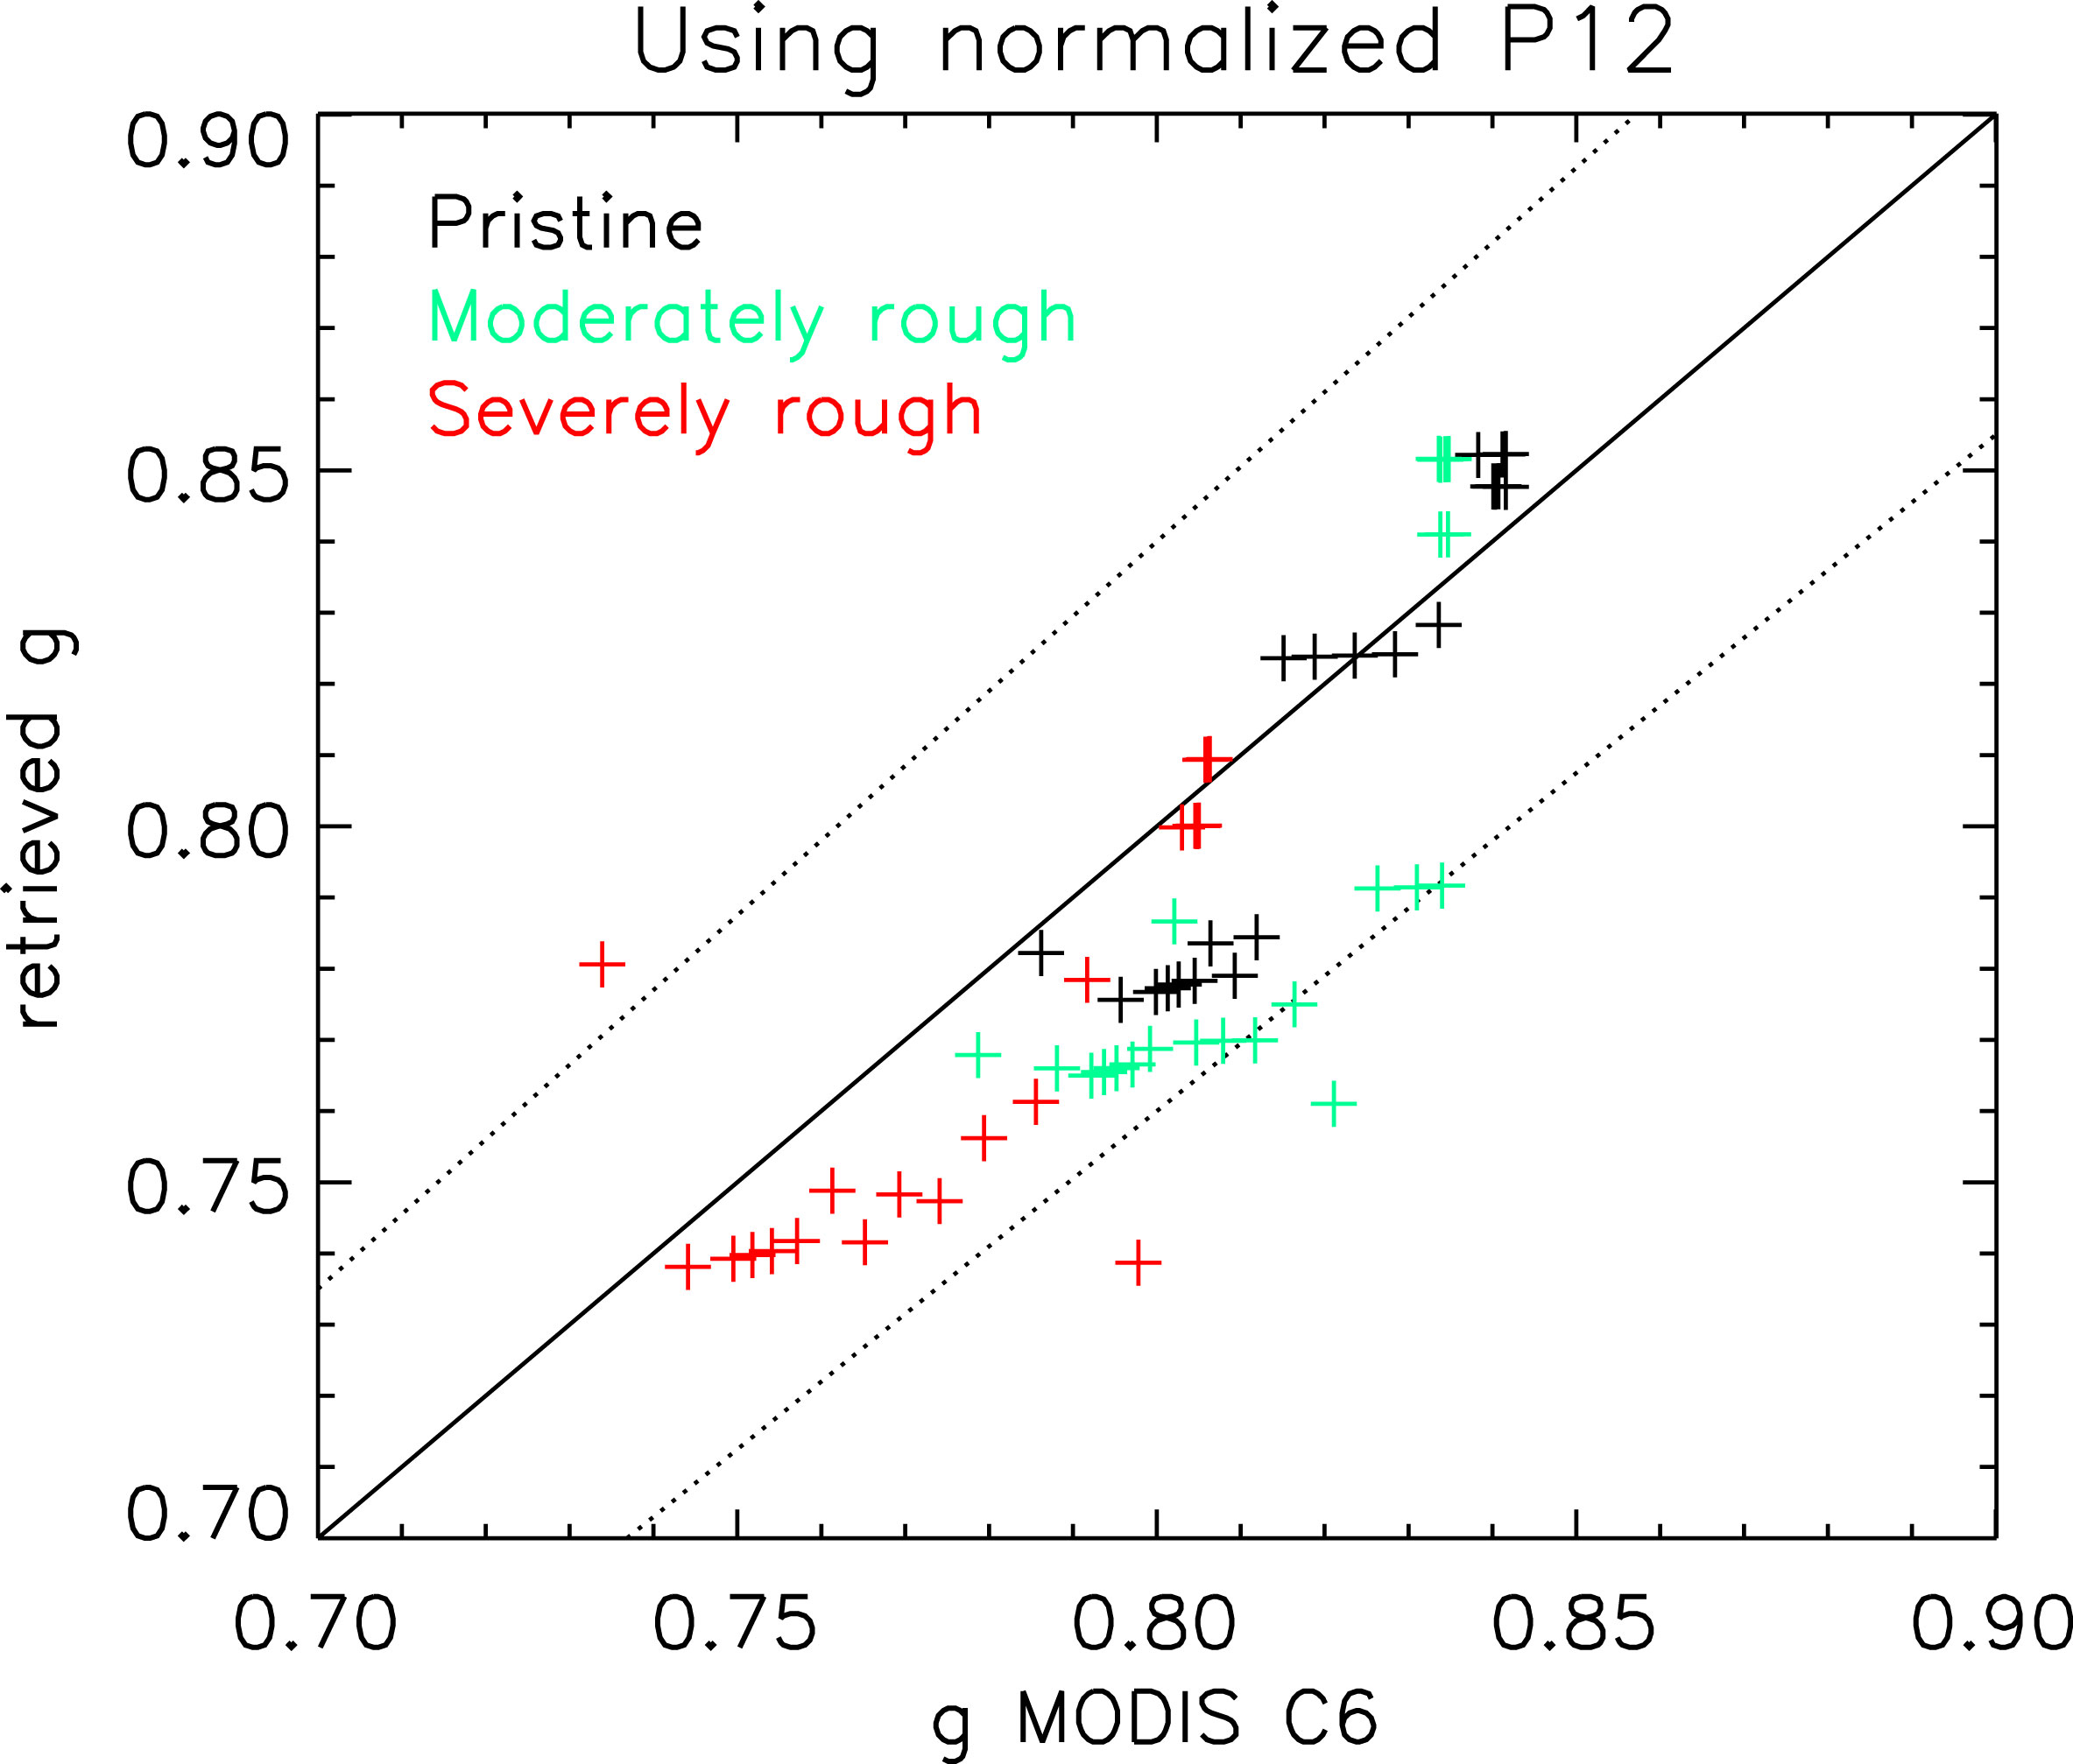
Clouds
Ice Clouds
The polarization and scattering behavior of more complex particles is captured to a large extent by simple hexagonal particles with a range of aspect ratios and roughnesses/distortions

Slide 47
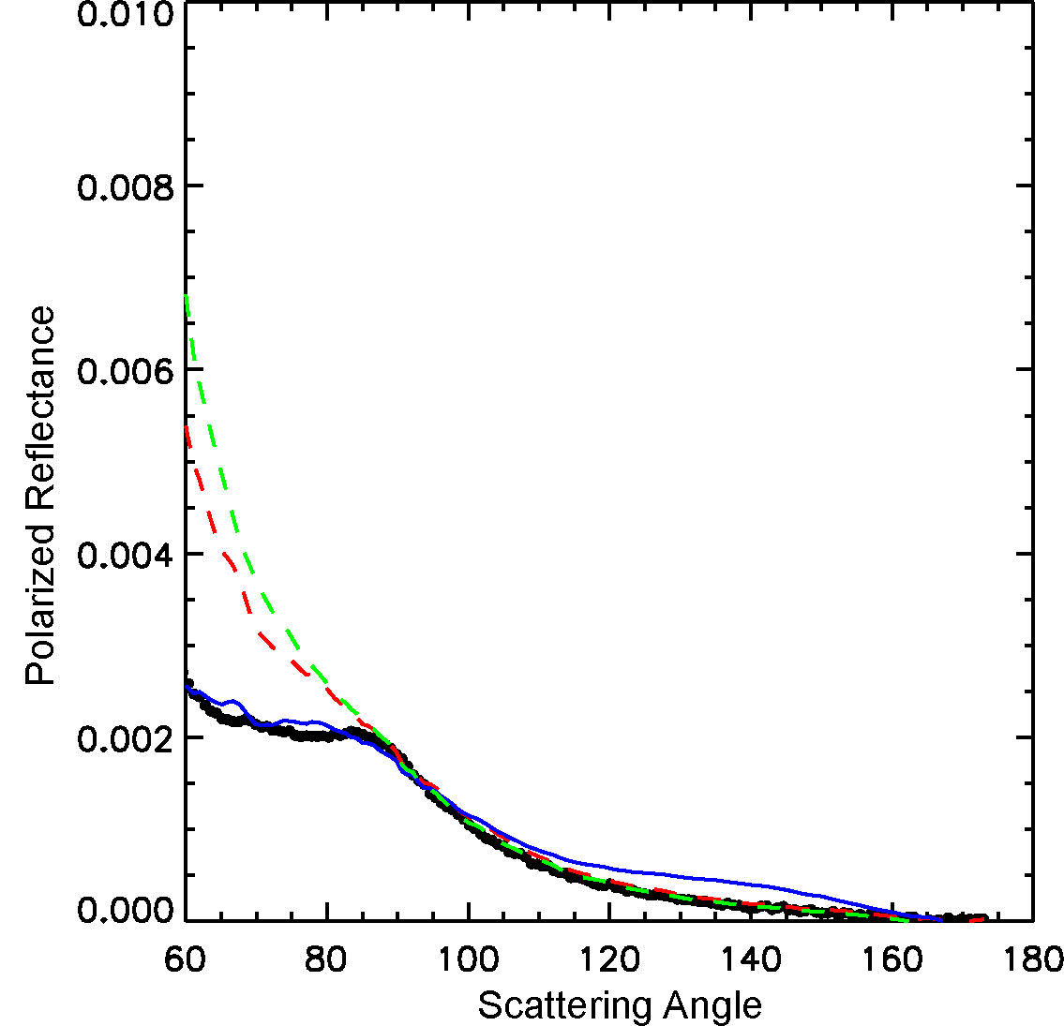
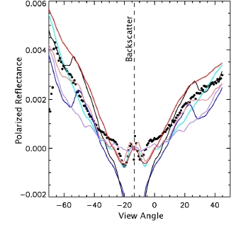
Clouds
Ice Clouds
For coldest clouds and contrails spheroidal particles appear to be present
Optical depth (0.1) & size distribution in agreement with lidar & in situ data
Oblate spheroids provide best model match to observations for this contrail
50 µm fractal crystals
mix with 25% hexagonal plates
mix with 25% 5 µm spheroids
polarized reflectance
1880 nm channel
No inversion
scattering angle

Slide 48
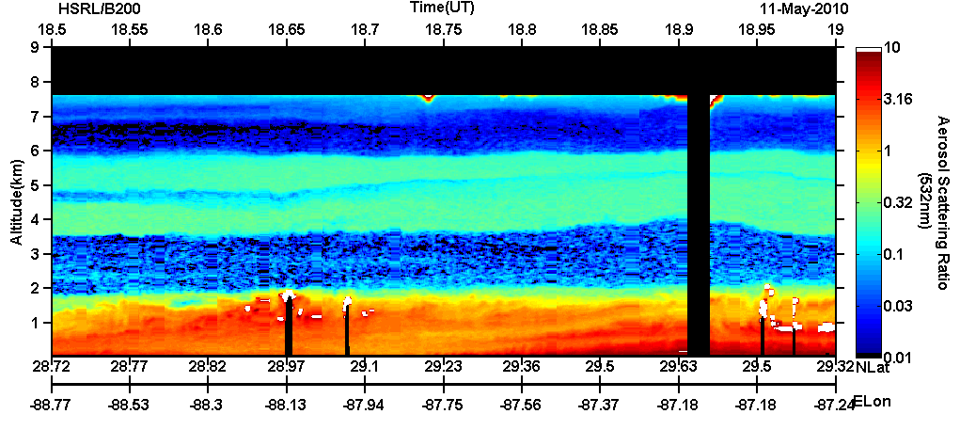
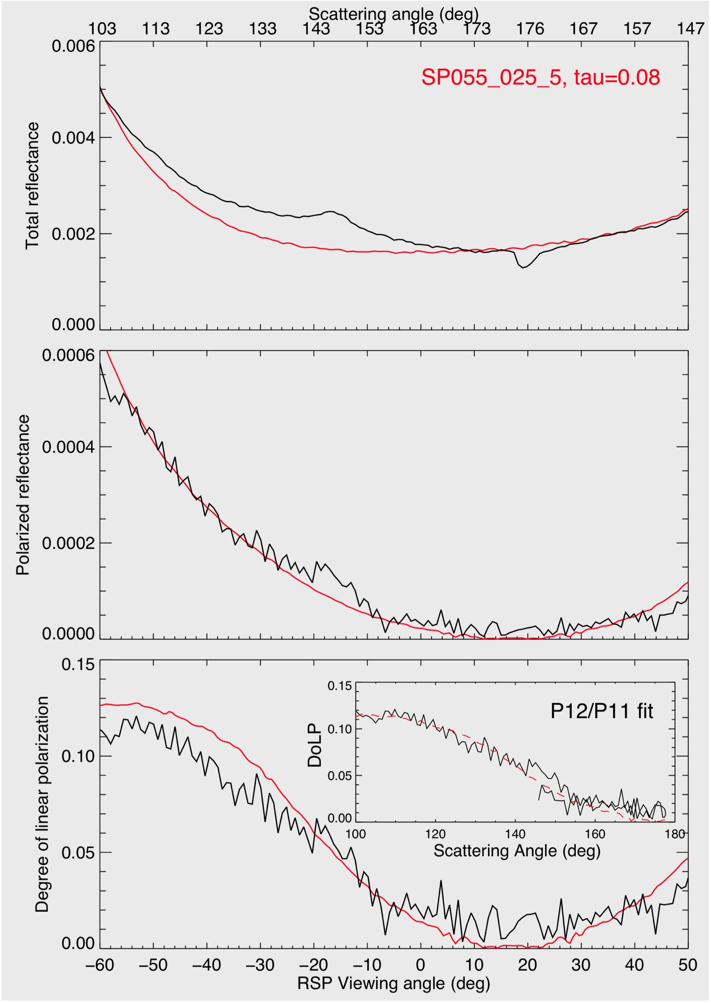
Clouds
Ice Clouds
Estimates of particle shape can be made using polarization observations even for very thin clouds
Cirrus beneath the aircraft
Aircraft shadow
Oriented crystals
BLACK: data
RED: fit
RT simulation:
  Cirrus optical depth= 0.08 (subvisual)
Degree of linear polarization fit to phase matrix database:
  Small roughened plates
  Effective radius ~9 um
  Aspect ratio =0.25
  Roughness parameter = 0.55

Slide 49
Summary
Aerosols:
  Need good understanding and modeling of surface/ocean body if aerosol retrievals are to be successful.
  Uniform distribution of aspect ratios is current baseline model for dust/soil.
  Aerosol absorption and size distribution validated for retrievals over land from ARCTAS, spectral optical depths from CLAMS, CSTRIPE, ALIVE and MILAGRO.
Aerosol above cloud:
  Typical accumulation mode aerosols generate significant polarization at 865/670 nm. Capability to retrieve aerosol absorption above cloud improved by use of reflectance
  Aerosol retrieval above cloud improves cloud top pressure estimate and is necessary in the presence of heavy aerosol loads.
Cloud Properties:
  Droplet effective radius and effective variance at cloud top. Effective radius within cloud from reflectance and crude estimate of particle size profile from reconciliation of size retrievals.
  Ice shape ID from polarization.
  Cloud optical depth and particle size from reflectance.
  In clouds absorption estimate allows determination of pressure thickness and hence N_{c}

