Slide 1
Constraining Global Estimates of Aerosol Direct Radiative Forcing and Surface Concentrations
Glory Science Team
08/12/2011
Daven K. Henze, Brian Meland, University of Colorado Boulder
Jun Wang, Xiaoguang Xu, University of Nebraska Lincoln
Drew Shindell, NASA GISS
Robert Spurr, RT Solutions
Monika Kopacz, Kumaresh Singh, Changsub Shim
c
G
adj

Slide 2
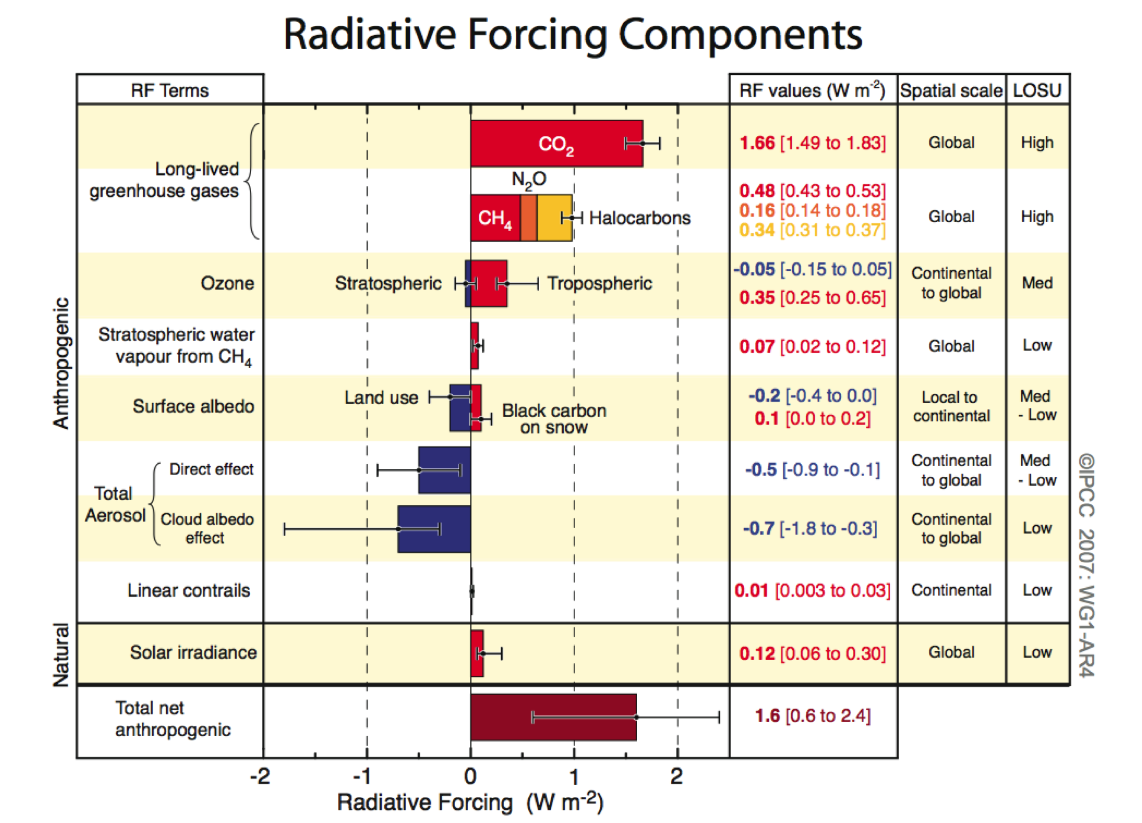
Short Lived Climate Forcing Agents
Aerosol DRF: large and uncertain
AR4, Forster et al.,
2007

Slide 3
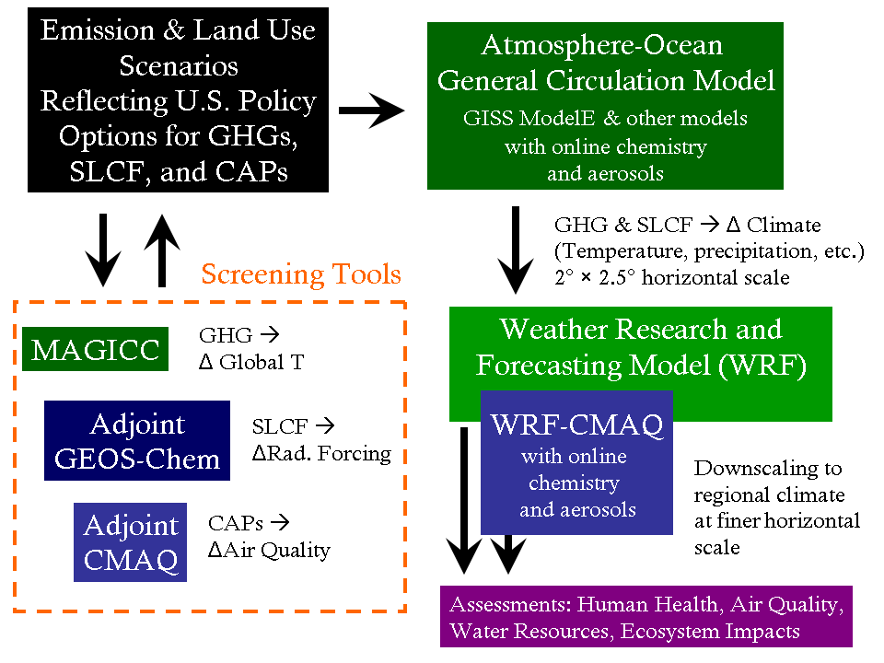
Systems for modeling air quality & climate change

Slide 4
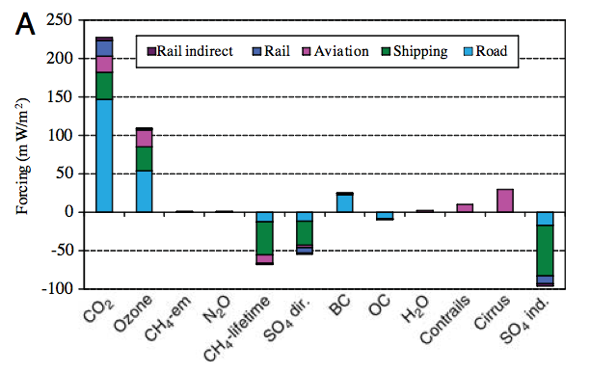
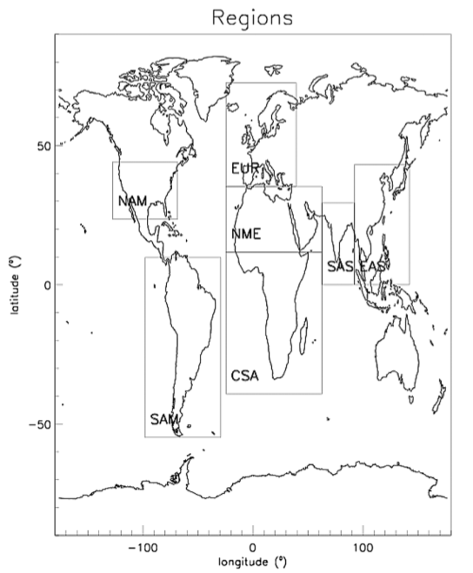
Refining the RF bar chart
Sector specific contributions: Fuglestvedt et al., 2008
Sector and regional specific contributions: Unger et al., 2008
Unger et al., 2008

Slide 5
Systems for modeling air quality & climate change
Calculating DRF becomes computationally intractable...

Slide 6
Radiative Forcing Transfer Functions
How to calculate the radiative forcing change for
a given change in emissions?
Using transfer function T:

Slide 7
Radiative Forcing Transfer Functions
How to calculate the radiative forcing change for
a given change in emissions?
Using transfer function T:
Approximate T using adjoint:

Slide 8
Radiative Forcing with GEOS-Chem
Forward model
Sensitivity calculation:
GEOS-Chem
GC Adj
Henze et al.,
2007
[SIA], [BC], [OC], D_{dry}
Mie Code
Mie Code
linearized
Radiative Transfer Code
Radiative Transfer Code
LIDORT (Spurr, 2002)
Weighting functions
TOA upward SW flux

Slide 9
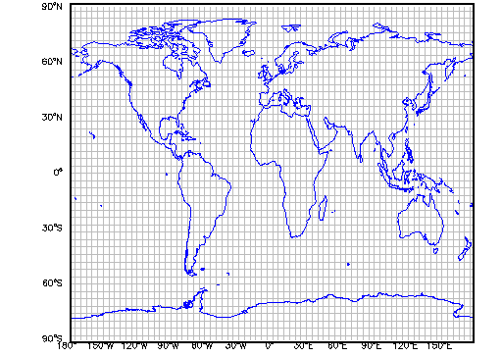
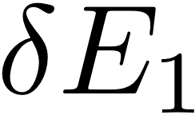
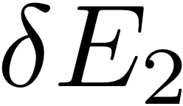
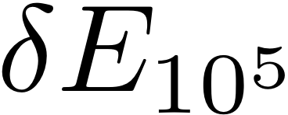
Aerosols and Radiative Forcing
Sensitivities from every sector and region:
Calculated very efficiently using GEOS-Chem adjoint
(Henze et al., 2007) and LIDORT (Spurr, 2002)

Slide 10
Direct Radiative Forcing efficiencies
The % change in radiative forcing per change in emission:
Emissions of BC
Emissions of NH₃
W m⁻² / (kg m⁻² yr⁻¹)
Variability indicates importance of hi-res analysis

Slide 11
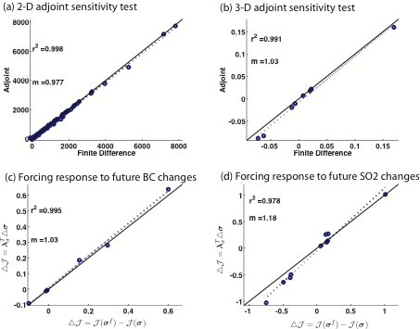
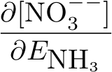
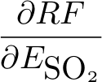
Validation
Notes:
\frac{\partial \mbox{[NO}_3^{--}]}{\partial {E}_{\mbox {NH}_3}}
\frac{\partial RF}{\partial {E}_{\mbox {SO}_2}}
\frac{\partial RF}{\partial {E}_{\mbox {BC}}}

Slide 12
Validation: lumped impacts
perturb x 100% | Adjoint esitimate [W/m²] | Forward model RF [W/m²]
OC | -0.10 | -0.13
BC | 0.23 | 0.21
SO2 | -0.27 | -0.27
NH3 | -0.07 | -0.06
NOx+NH3+SO2 | -0.72 | -0.86

Slide 13
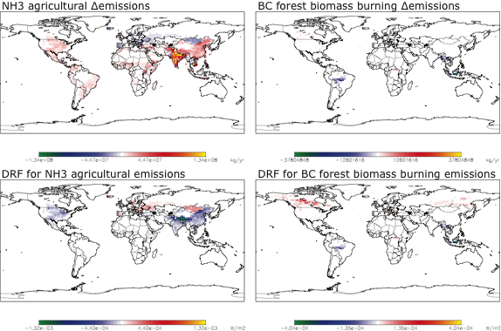
Apply to RCP45 2050 scenario

Slide 14
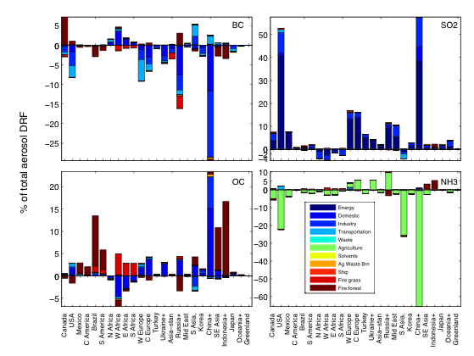
Apply to RCP45 2050 scenario

Slide 15
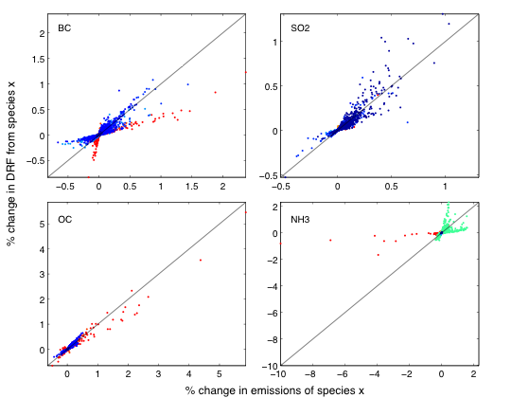
Efficiency vs magnitude of emissions
Consider the cell-by-cell relationship:

Slide 16
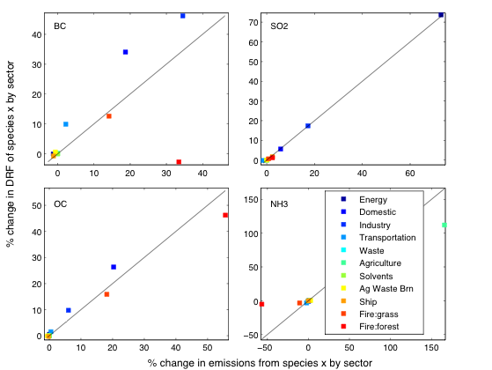
Efficiency vs magnitude of emissions
aggregated by sector:

Slide 17
Ok, but what is Gloryous about this?
1. Species / Sectors / Regions with large heterogeneity in efficiency and large uncertainty in emissions play large role in DRF.
Improving estimates of aerosol sources and distributions will lead to enhanced utility of DRF.
Observations from APS / RSP and additional platforms can help us constrain these factors.
Focus on radiative forcing rather than effects:
- how much of the influence comes from
anthropogenic emissions?
- what is the RF for different emissions scenarios?
--> potential as screening tool

Slide 18
What role does polarimetry play?
Have considered constraints on aerosol properties and aerosol classification.
To what extent could APS observations provide constraints on aerosol composition vs model parameters?
To what extent can these constraints be propogated back through a model to constraints on sources?
Focus on radiative forcing rather than effects:
- how much of the influence comes from
anthropogenic emissions?
- what is the RF for different emissions scenarios?
--> potential as screening tool

Slide 19
Sensitivity of polarization with respect to layer-by-layer aerosol properties using VLIDORT+linearized MIE
w.r.t. mean radius
• relate to emissions
• test more conditions
• explore more multi-
facted metrics
• develop rankings
Focus on radiative forcing rather than effects:
- how much of the influence comes from
anthropogenic emissions?
- what is the RF for different emissions scenarios?
--> potential as screening tool
w.r.t. refractive index
Brian Meland, CU Boulder

Slide 20
In practice: regional scale assimilation
Have begun with MODIS:
a priori SO₂ emission
optimized SO₂ emission
Focus on radiative forcing rather than effects:
- how much of the influence comes from
anthropogenic emissions?
- what is the RF for different emissions scenarios?
--> potential as screening tool
Xiaoguang Xu, UNL
Will continue with RSP+

Slide 21
Final remarks
Adjoint sensitivities can provide high-resolution estimates of aerosol DRF
The same tools can be used to rank optically based metrics in terms of constraint potential
The same tools can be used for assimilation of remote sensing products in a cyclic process of improving model estimates of radiative forcing
Focus on radiative forcing rather than effects:
- how much of the influence comes from
anthropogenic emissions?
- what is the RF for different emissions scenarios?
--> potential as screening tool

Slide 22
the end
Focus on radiative forcing rather than effects:
- how much of the influence comes from
anthropogenic emissions?
- what is the RF for different emissions scenarios?
--> potential as screening tool

