Slide 1



HSRL Measurement Details and Data
Chris Hostetler¹, John Hair¹, Richard Ferrare¹, Sharon Burton¹, Ray Rogers¹, Mike Obland¹, Carolyn Butler², Amy Jo Swanson², Anthony Cook¹, David Harper¹, Bruce Anderson¹, Antony Clarke³, Cam McNaughton³, John Ogren⁴, Elisabeth Andrews⁴, Charles Brock⁴, Dan Lack⁴, John Hubbe⁵, Stephen Springston⁶, Jens Redemann⁷, Phi Russell⁸, Brent Holben⁹
¹NASA/LaRC; ²SSAI; ³SOEST-Univ. Hawaii; ⁴NOAA ESRL; ⁵PNNL; ⁶BNL; ⁷BAERI; ⁸NASA/Ames; ⁹NASA/GSFC
Sponsors
NASA CALIPSO Project
NASA HQ Science
Mission Directorate
Radiation Sciences Program
Department of Energy
Atmospheric System Research

Slide 2
The HSRL Technique

Slide 3
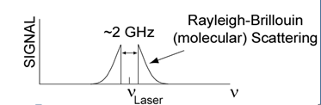
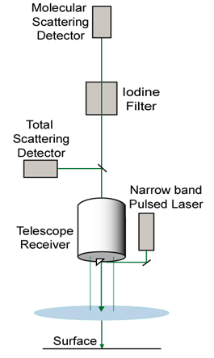
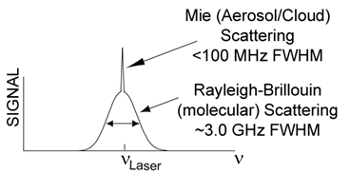
Basic principle behind High Spectral Resolution Lidar (HSRL)
By tuning the laser to an iodine gas absorption line, this channel measures only the broadened molecular backscatter (the particulate backscatter is absorbed by the iodine gas).
This channel measures the full spectrum of backscatter, including the particulate (Mie) backscatter and the broadened molecular backscatter
Notes:
This is a conceptual block diagram for an HSRL system and the spectral distributions of the signals measured by the two channels.
The HSRL technique takes advantage of the spectral distribution of backscatter. This is the spectral distribution of total backscatter. Backscatter from molecules is pressure broadened by several GHz whereas the frequency of the backscatter from the much more massive aerosol or cloud particles is basically identical to the transmitted frequency.
On the left, we see that the backscatter is split between 2 detectors. One detector is a basic backscatter detector. The other is downstream of an iodine vapor cell. This is a glass cell filled with iodine gas. By tuning the laser to an absorption feature in iodine, we can block the central portion of the spectrum leaving only the pressure-broadened wings of the molecular backscatter. The two channels give us a means to separate aerosol and molecular scatter, which is the first step in independently retrieving aerosol backscatter and aerosol extinction: i.e., the 2 channels give us 2 equations to solve for our two unknown. By contrast, a simple backscatter lidar has only one channel, and solving for the 2 unknowns requires making assumptions that can be highly uncertain.
Getting back to the ACE concept, the lowest risk architecture that we know of is an evolution of what we are currently flying on CALIPSO …..
--------------------------------
Light is transmitted into the atmosphere by a narrowband pulse laser. Backscattered photons are collected in a telescope receiver. Light is collimated in the aft optics following the telescope and is split into two optical paths. Approximately 10% is imaged directly onto a detector. The other 90% is directed through an iodine vapor cell and then is imaged onto a second detector.
The spectral distribution of the elastic backscatter from the laser is shown in the upper graph. The random thermal motion of molecules in the atmosphere cause a Doppler broadening of the return. The width of the broadening is about 3 GHz. Aerosol and cloud particles are much heavier and hence slower than gas molecules and consequently the scatter (broadening) from these particles is negligible. For all practical purposes, the aerosol backscatter comes back with the same spectral distribution of the laser pulse.
The bottom figure shows the effect of the iodine absorption filter on the returns. The laser is tuned to the center of a narrow iodine absorption line. The vapor cell provides a notch filter in the frequency, effectively blocking the aerosol returns in the “molecular scatter” channel. The profile of molecular scatter can be compared to a model density profile to deduce cloud/aerosol extinction. By taking the ratio of the signals in the two channels, one can separately derive the molecular and aerosol components of the backscatter signal return

Slide 4
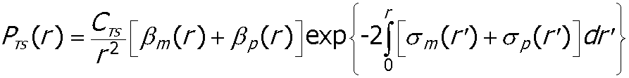
HSRL: 2 equations, 2 unknowns
Measured Signal on Molecular Scatter (MS) Channel:
Particulate
Extinction
Measured Signal on Total Scatter (TS) Channel:
Particulate
Backscatter
Retrieved
Parameters
Ext/Backscatter
Notes:
4
Here I have shown the equation that we measure in the (filtered) molecular scattering channel.
We see that the measured signal in the filtered channel will only depend on the particulate extinction. Again we obatin the molecular backscatter and extinction coefficients are from a model or the meterological analyses.
Additionally, the particulate backscatter can be derived by taking the ratio of the total scattering channel to the molecular scattering channel.
With HSRL we have two measurements, giving us two equations to solve for the two unknowns.
There is also another important aspect that HSRL has concerning calibration of the backscatter measurement.
A particular advantage for the HSRL technique is that it only requires the relative transmission and gain of the two channels, which with a carefully designed system, can be done internal and would not require a normalization to a clean (aerosol-free) region, typically needed for standard backscatter lidar.
The HSRL technique does require the Iodine filter transmission to also be known which is simply measured in the lab.
A particular advantage that the HSRL technique has over nadir-viewing aircraft-based backscatter lidars concerns calibration of the backscatter measurement. Backscatter lidars are typically calibrated by comparing the signal from a volume of air assumed to be free of aerosols and clouds to the backscatter coefficient for that volume estimated from a model or rawinsonde data. In the case of nadir-viewing airborne backscatter lidars, it can be difficult to find regions in the observed profiles where aerosol loading is negligible and/or recognize such regions when they are encountered. On the other hand, a properly designed HSRL system is essentially self-calibrating, and does not require identification of regions of clear air to convert measured signals into accurate backscatter and extinction profiles. The HSRL extinction retrieval does, however, require careful laboratory characterization of the shape, but not absolute transmission, of the iodine absorption feature. Also, the HSRL backscatter retrieval requires calibration of the relative transmission and gain of the molecular and total backscatter channels, which can be done once or twice a flight. HSRL calibrations are therefore internal to the instrument and can be done accurately and reliably.

Slide 5
The Instrument

Slide 6
Important System Characteristics
Calibration
  Internal calibration of electro-optic gains between parallel and perpendicular polarization channels
  Internal calibration of “molecular” to parallel backscatter channel at 532 nm
    532 nm aerosol backscatter, depolarization, and extinction retrieved without external calibration to atmospheric target
  1064 nm backscatter calibrated using information from 532 nm aerosol backscatter
    Normalized to estimated total backscatter at “cleanest” point in profile
    532 nm aerosol backscatter used to estimate 1064 aerosol backscatter at calibration altitude
Alignment
  Autonomous bore-sight alignment every 10 sec
For a description of system and technique,
see Hair et al., Appl. Optics, 2008
Notes:
Quantify calibration – how well we know clear air – 1-2% level for clear air
Autonomous bore-sight for alignment (every 10 sec?) – important for keeping system alignment for extinction, 1064 backscatter

Slide 7
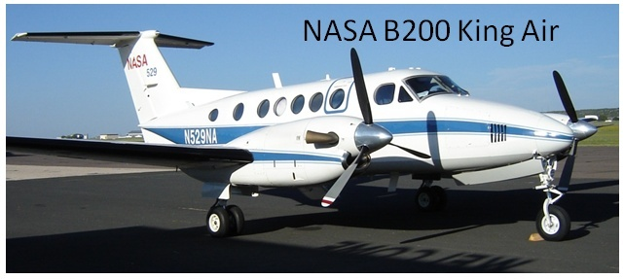
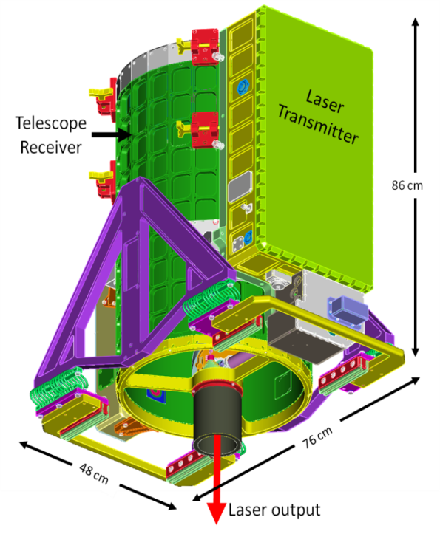
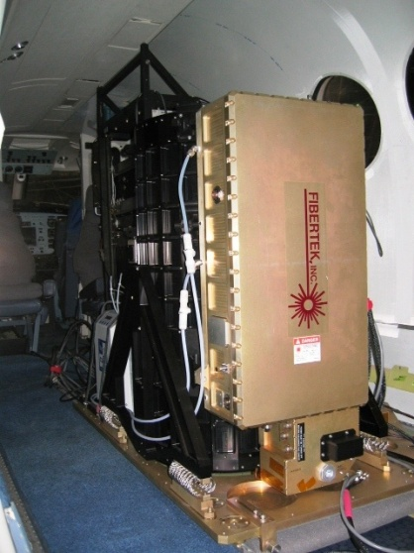
Airborne High Spectral Resolution Lidar (HSRL)
Capabilities: 1-α, 2-β, 2-δ
  HSRL at 532 nm (iodine technique)
  Backscatter lidar at 1064 nm
  Depolarization at both 532, 1064 nm
History
  2000-2004: instrument development
  Dec 2004: first test flight on Lear 25-C
  Dec 2005: first test flight NASA King Air
  2006-present: ~3 campaigns/year
NASA B200 and UC12 King Air
  27-28 kft (~9 km) nominal altitude
  Aircraft speed 200-220 knots
  Aircraft duration ~3.5-4.5 hours
  Typical payload:
    HSRL
    Research Scanning Polarimeter (RSP)
    Digital Camera
Notes:
7
Has several built-in internal calibration features.
- polarization gain ratio
- cal between molecular and aerosol backscatter at 532
- autonomous boresight system that maintains alignment of transmitter and receiver
Deployed on field campaigns with no instrument problems – never touched the instrument during the month-long field campaigns we have participated in.
Weight ~ head (250 lbs)
rack (400 lbs) single rack ~ 42 inches tall (except chiller)

Slide 8
Measurements

Slide 9
HSRL Aerosol Measurements
Parameter | Wavelength (nm) | Property | Horizontal Resolution (Δx) (km) | Vertical Resolution (Δz) (m)
Aerosol Scattering Ratio | 532 | Extensive | 1 | 60
Aerosol Backscatter Coefficient | 532, 1064 | Extensive | 1 | 60
Aerosol Extinction Coefficient | 532 | Extensive | 6 | 300
Aerosol Backscatter Wavelength Dependence | (1064/532) | Intensive | 1 | 60
Aerosol extinction/backscatter ratio “lidar ratio” | 532 | Intensive | 6 | 300
Aerosol depolarization | 532, 1064 | Intensive | 1 | 60
Ratio of Aerosol Depolarization | (1064/532) | Intensive | 1 | 60
Extensive - depends on aerosol amount and type Intensive – depends on aerosol type

Slide 10
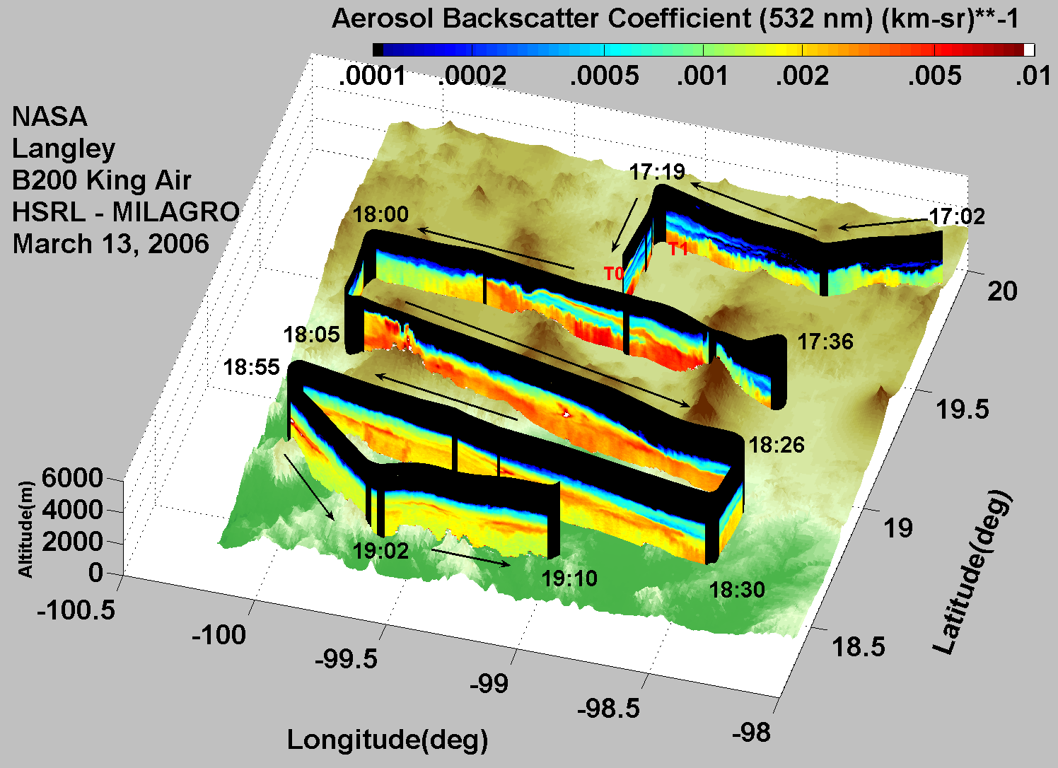
Characterizing Spatial Distribution of Aerosol Optical Properties

Slide 11
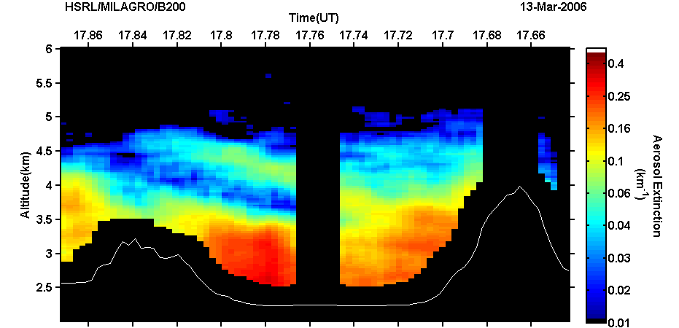
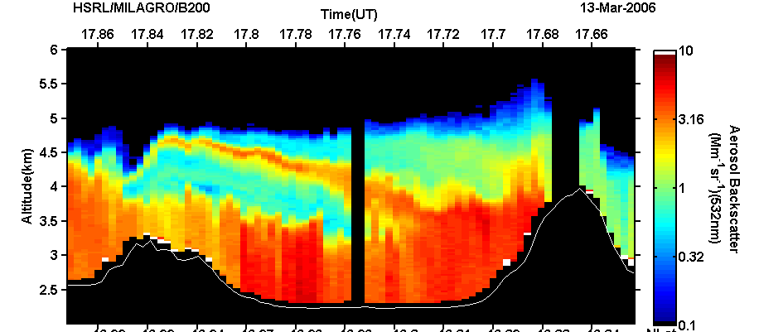
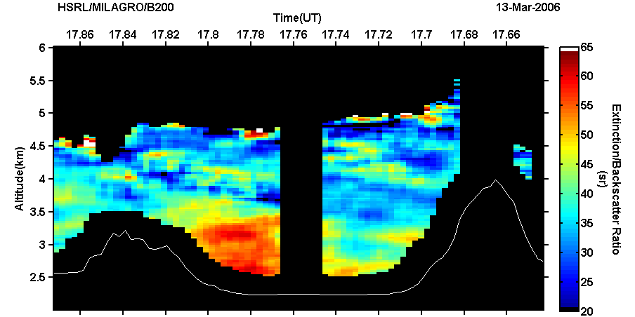
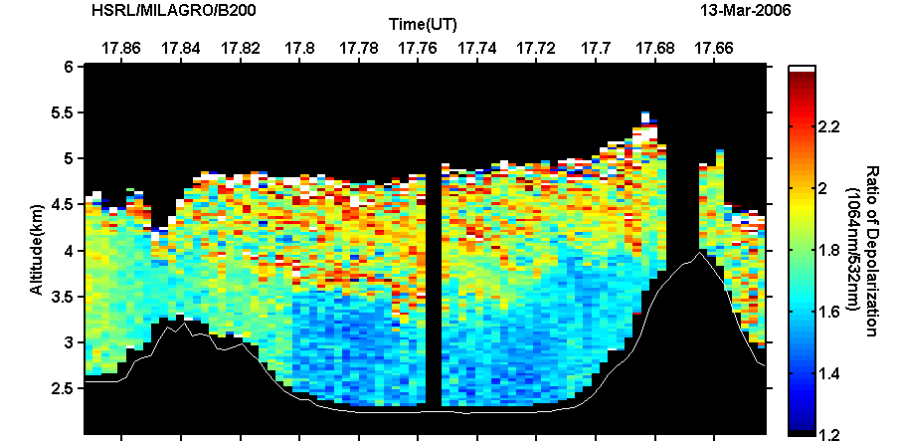
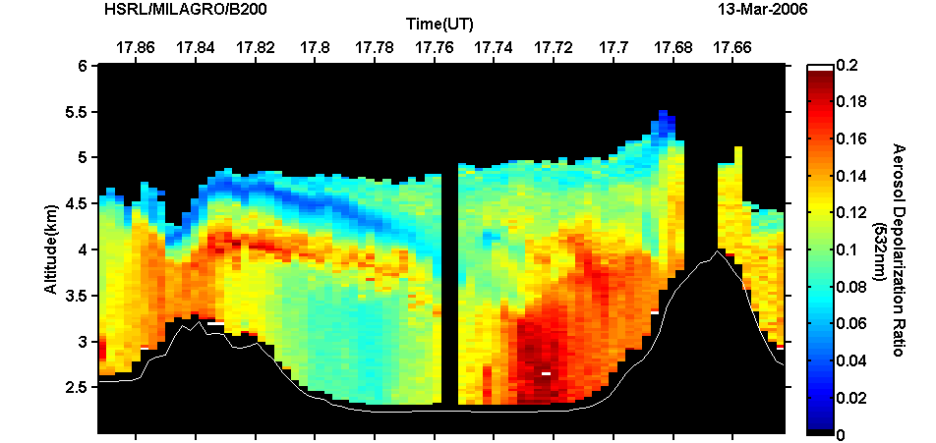
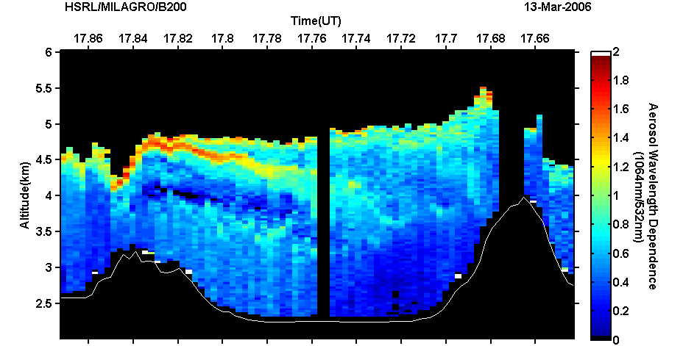
Aerosol Characterization using HSRL aerosol measurement suite
LaRC Airborne HSRL Measurements over Mexico City, March 13, 2006
  western part of city- high S_{a}, high WVD, low depolarization – urban aerosol
  eastern part of city - low Sa, low WVD, high depolarization – dust
Extinction
AOT (532 nm)
Backscatter (532 nm)
Extinction/Backscatter Ratio (532 nm)
west
east
west
east
west
east
~ 100 km
Depolarization Ratio (1064/532 nm)
Depolarization (532 nm)
Backscatter λ Dependence
(1064/532 nm)
west
east
west
east
west
east
west
east

Slide 12
Evaluation/Validation

Slide 13
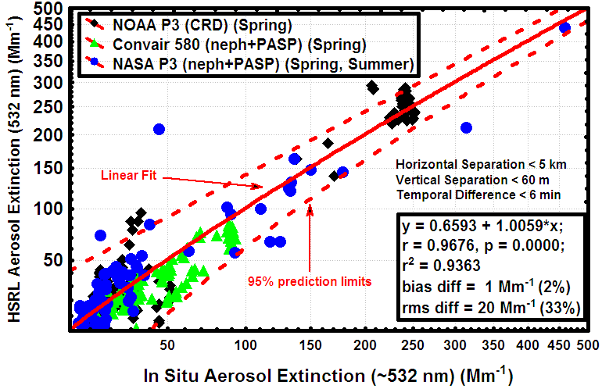
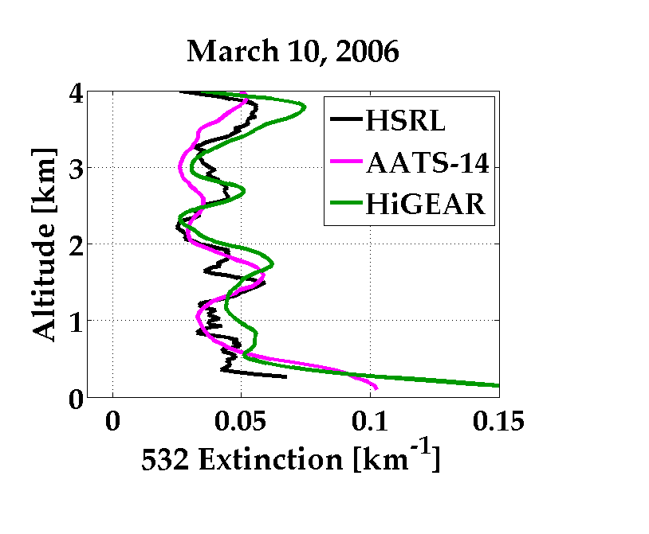
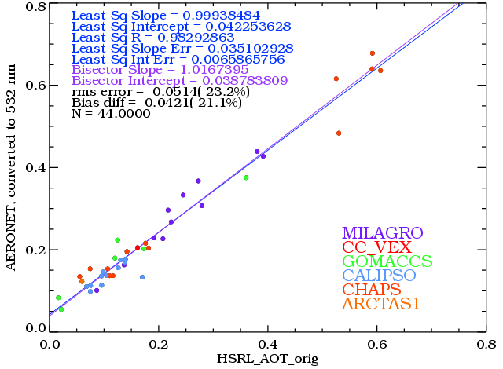
HSRL Comparisons of Aerosol Extinction and Optical Depth
Aerosol extinction and optical depth compared to airborne in situ and remote sensing instruments
ARCTAS (Spring)
Validation – aerosol extinction
- bias differences ≤ 3 Mm⁻¹
- rms differences ≤ 15 Mm⁻¹
Rogers et al., (2009)- MILAGRO 2006
AERONET AOT
HSRL AOT

Slide 14
Field Missions

Slide 15
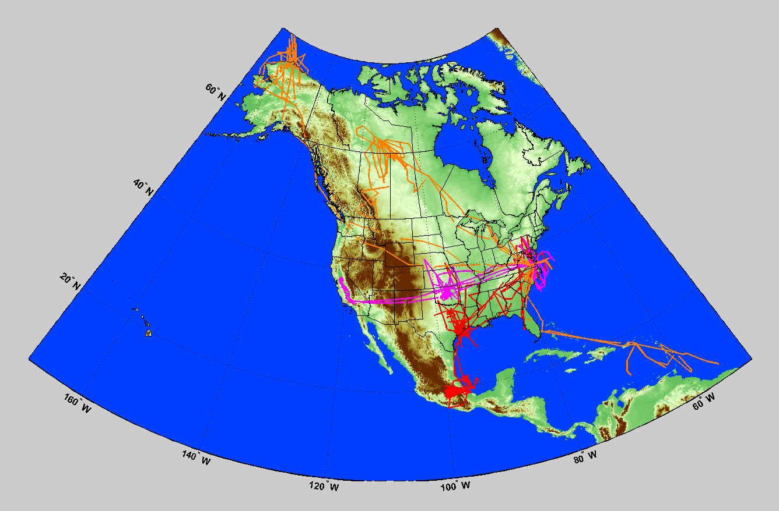
King Air B200/UC12 Field Campaigns with Langley High Spectral Resolution Lidar (HSRL)
2000-2004: instrument development and integration
Dec 2004: first test flight on Lear Jet
Dec 2005: first test flight NASA Langley B200 King Air
Field Campaigns: 2006 (3), 2007 (3), 2008 (3), 2009 (3), 2010(3), 2011(2)
ARCTAS 1 (NASA-DOE-NOAA)
April 1-20, 2008
CHAPS (DOE-NASA)
June 3-29, 2007
RACORO (DOE-NASA)
June 3-26, 2009
CALIPSO/MODIS/CATZ (NASA)
January 17– Aug 11, 2007
Ocean Subsurface (NASA-ODU-NYU)
September 9-29, 2009
DISCOVER-AQ (NASA)
July 2011
ARCTAS 2 (NASA)
June 25 – July 14, 2008
CalNex (NOAA) May 12-25, 2010
CARES (DOE)
June 3-28, 2010
CALIPSO Validation (NASA)
June 14 – Aug 10, 2006
January 22 – April 17, 2009
March 2011
San Joaquin Valley (EPA)
February 8-21, 2007
Caribbean CALIPSO Val. (NASA) Jan. 22 – Feb. 3, 2008
TexAQS II/GoMACCS
NOAA-DOE-NASA
Aug 27 – Sep 29, 2006
Airborne HSRL has logged
>1077 science flight hours
>330 science flights on NASA Langley B200/UC12
MAXMex/MILAGRO/INTEX-B
DOE-NSF-NASA-Mexico
March 1-30, 2006
Birmingham (EPA)
Sept 16-Oct 16, 2008

Slide 16
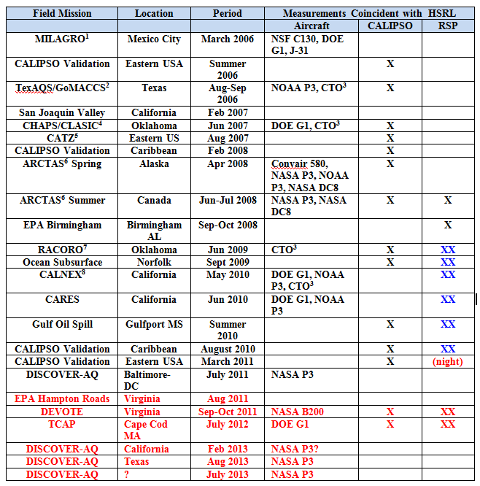
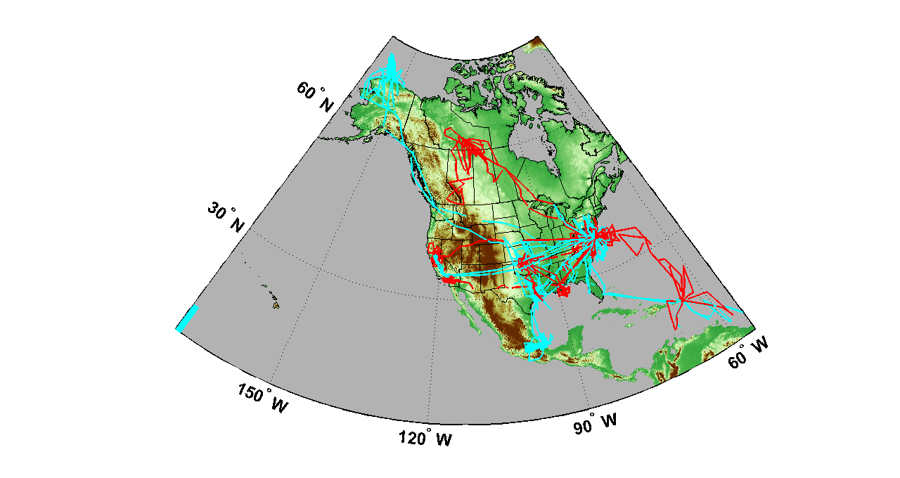
HSRL King Air B200/UC12 Field Campaigns
HSRL
1077 hours
330 flights
HSRL+RSP
367 hours
111 flights
B200 Attitude Data | Crossbow Accuracy (X) | Applanix unprocessed accuracy* (XX)
Vx, Vy, Vz | < ~0.5 m/s | < ~0.05 m/s
Roll, Pitch | < 0.75 degrees | < 0.008 degrees
Heading | < 3.0 degrees | <0.07 degrees
Later B200 campaigns had more accurate aircraft attitude data

Slide 17
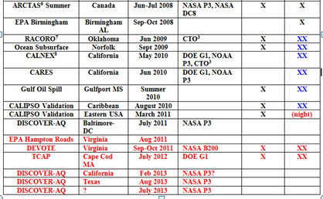
King Air B200/UC12 Field Campaigns with HSRL+RSP
HSRL
1077 hours
330 flights
HSRL+RSP
367 hours
111 flights
B200 Attitude Data | Crossbow Accuracy (X) | Applanix unprocessed accuracy* (XX)
Vx, Vy, Vz | < ~0.5 m/s | < ~0.05 m/s
Roll, Pitch | < 0.75 degrees | < 0.008 degrees
Heading | < 3.0 degrees | <0.07 degrees
Later B200 campaigns had more accurate aircraft attitude data

Slide 18
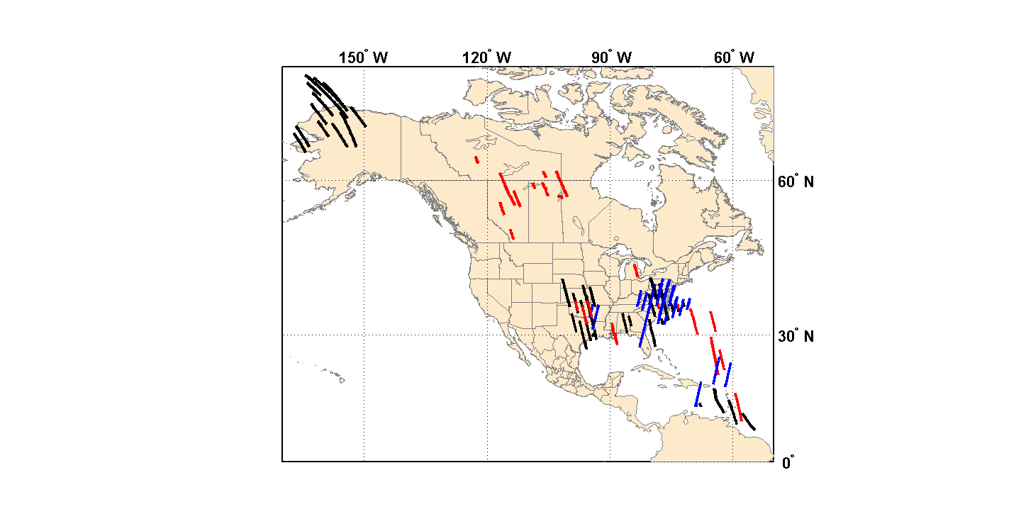
King Air B200/UC12 Field Campaigns with HSRL and RSP measurements along CALIPSO tracks
Along CALIPSO tracks
  HSRL:
    104 flights
    142.4 hours
  HSRL+RSP:
    24 flights
    26.1 hours
HSRL (Day)
HSRL+RSP (Day)
HSRL (Night)

Slide 19
HSRL Data Availability

Slide 20
HSRL Data Availability
Level 2 products (e.g. backscatter, extinction, AOD, depolarization profiles) available in hdf and/or ascii ICARTT formats from one or more locations
  NASA GTE Archive
    Ex. INTEX-2 (MILAGRO), ARCTAS, DISCOVER-AQ
  DOE ARM IOP Archive
    Ex. CHAPS/CLASIC, RACORO, CARES/CALNEX
  NASA LaRC ftp site
    Ex. CALIPSO Validation, Gulf Oil Spill
Additional products available via ftp upon request
  PBL heights
  Aerosol classification

Slide 21
Airborne Ozone DIAL and HSRL

Slide 22
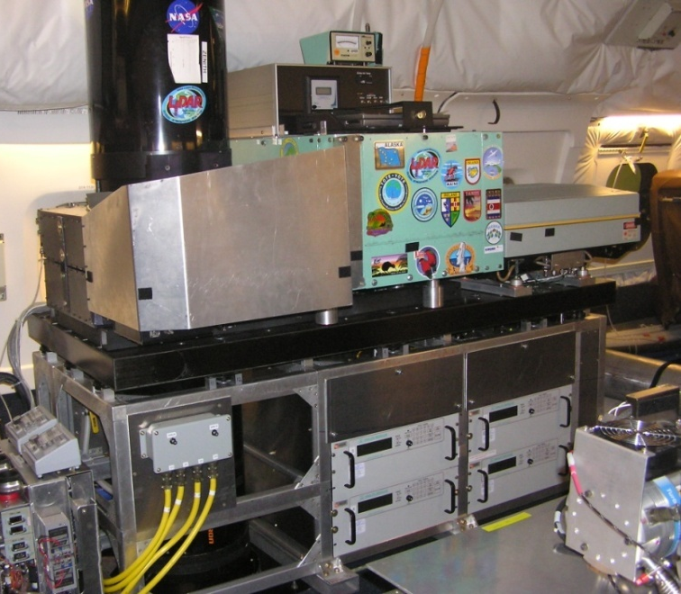
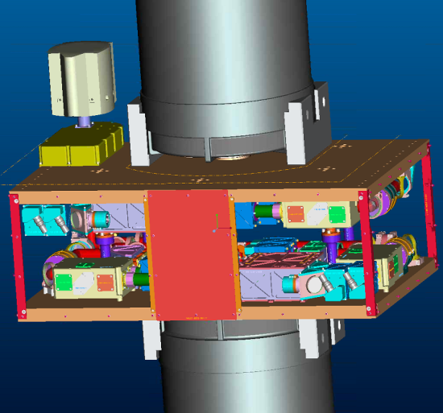
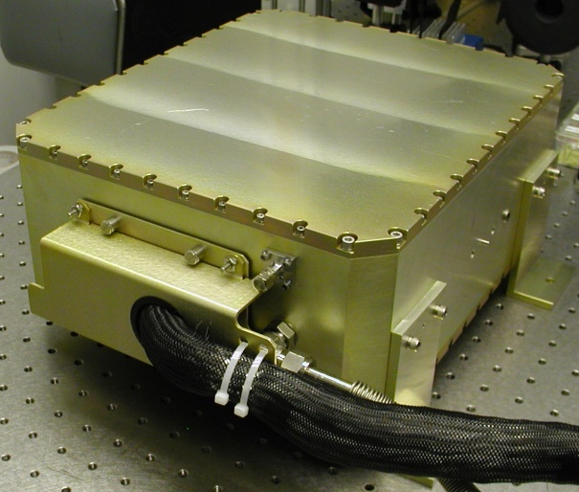
Airborne Ozone DIAL & HSRL - AITT
Current DIAL on NASA DC-8
AITT DIAL-HSRL on NASA DC-8
HSRL Receiver
Single Freq. Laser
Objective - reconfigure and upgrade the NASA LaRC airborne ozone DIAL with recent technology developments from the HSRL – IIP project
  Integrate the technologies onto the DIAL system to enable nadir and zenith HSRL measurements of aerosols and clouds.
    DIAL system will maintain its current capability for ozone measurements
    Nadir and zenith measurements of ozone (DIAL) and aerosol+clouds (HSRL)
    Operate from NASA DC-8 with same overall footprint and weight as current DIAL
    First deployments of upgraded system - DC3 and SEAC⁴RS (Summer-Fall 2012)

Slide 23
Airborne Ozone DIAL & HSRL
Increased Measurement Capability
Current
Mods in progress for 2011 DC-8 deployments
Potential
Future Capability
*DIAL-HSRL 355 & 532 nm HSRL is not part of current AITT program

Slide 24
Future Plans

Slide 25

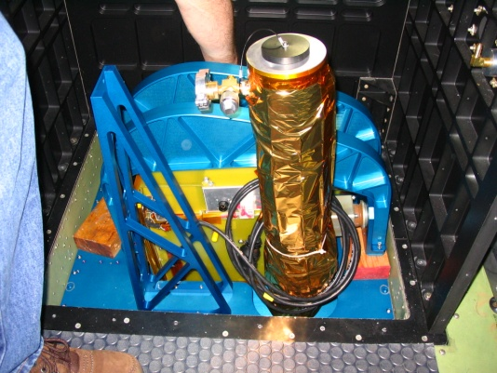
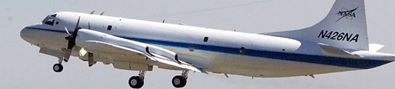
Modification of HSRL-I and RSP for ACE and Geo-CAPE Applications from the NASA P-3B
Objective
  Increase capability the airborne High Spectral Resolution Lidar (HSRL) for applications to
    Air-sea gas (CO₂) exchange
    Ocean color
    Ocean-Aerosol Interaction
    Cloud extinction and cloud droplet number density
  Improve the functionality and reliability of the Research Scanning Polarimeter (RSP)
  Adapt both instruments to fly on the Wallops P-3B to enable long-range over-ocean flights to assess ACE and Geo-CAPE remote sensing strategies
Approach
  Increase the vertical resolution of the HSRL by upgrading the detector modules and data acquisition system from 5 MHz sampling to 100 MHz sampling for ocean surface/subsurface and in-cloud measurements.
  Upgrade/harden the RSP instrument
    New data acquisition system
    New ruggedized heater controller
  Develop and certify mounting hardware, cabling, and equipment racks for flying HSRL and RSP on the P3-B
P3 Checkout flights anticipated around Sept. 2012
HSRL in LaRC B200
RSP in LaRC B200
Wallops P3-B

Slide 26
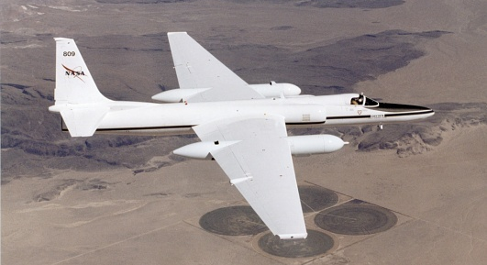
Under development: Multiwavelength HSRL
Multiwavelength HSRL: 3β+2α+3δ
  Backscatter at 3 wavelengths (3β) : 355, 532, 1064 nm
  Extinction at 2 wavelengths (2α) : 355, 532 nm
  Depolarization at 3 wavelengths (3δ): 355, 532, and 1064 nm
  Goal: enable layer-resolved, aerosol microphysical and macrophysical retrievals (Müller et al., 1999, 2000, 2001; Veselovskii et al.,2002,2004, ) from a high-altitude aircraft
    Effective and mean particle radius, concentration (volume, surface), complex index of refraction, single scatter albedo
    Retrievals to be accomplished via collaboration with Detlef Müller et al.
  Anticipate 3β+2α+3δ data extremely powerful in combined lidar-polarimeter retrieval
Platforms: NASA B200/UC12 and ER-2 high altitude (20 km) aircraft
  Technology and science demonstration for future Aerosol-Clouds-Ecosystem (ACE) satellite mission
  Goal: fly the airborne multiwavelength HSRL with polarimeters (AirMSPI, RSP, and others) and cloud radars to investigate lidar+polarimeter retrievals
Notes:
Add chart on ACE after this

Slide 27
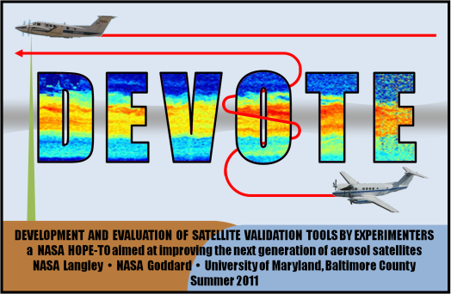


Future Field Missions
HSRL + RSP
  NASA DEVOTE
    HSRL-1
    Virginia, Sept-Oct 2011
    B200 In Situ measurements
    AERONET surface measurements
    CALIPSO underflights
  DOE TCAP
    HSRL-1 is baseline, HSRL-2 is goal
    Cape Cod, MA, July 2012
    DOE G1 In situ measurements
    DOE AMF, MAOS, AERONET surface measurements
DIAL+HSRL
  DC3
    Central USA
    June 2012
  SEAC⁴RS
    Southeast Asia
    August-September 2012
HSRL
  DISCOVER-AQ
    Caifornia central valley – Feb. 2013
    Houston, TX – Aug. 2013
    ??? – July 2014
Notes:
27

Slide 28
Thank You!
Questions?

